Slide 1
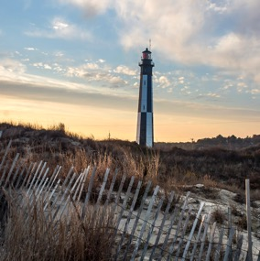
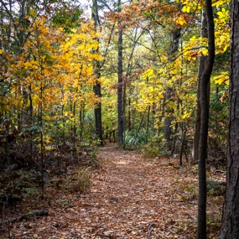

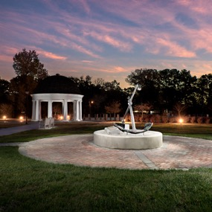
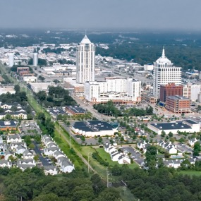

ImagineVB 2040 Comprehensive Plan
VBDA Open Session Briefing
Hank Morrison, AICP, CZA
June 18, 2024

Slide 2

History/Background
7 Comprehensive Plans in City history; first adopted in 1979
Most recent Comprehensive Plan: 2016
Update began in 2019; completed a survey in the Fall of 2019. Forced to pause process due to Covid-19 Pandemic
Restarted update in Summer 2022
Consultant team brought on Summer 2023
Notes:
Restarted update in Summer 2022 with a second community survey and interactive online maps

Slide 3

Status of Comp Plan Update
3 Surveys completed
Phase 1: Unifying Themes – Complete
  Consultant review of existing Planning documents
  5 Focus Groups – July 2023
Phase 2: Citywide Perspective – Complete
  5 Focus Groups – September 2023
  4 Public Workshops – November 2023
Phase 3: Planning Area Perspectives – 2024
  5 Public Meetings – May 8-16
  1 virtual opportunity in June
Phase 4: Technical Appendices – 2024
Phase 5: Plan Production – 2024
  Draft Plan expected August/September
Tentative Completion & Adoption – Fall/Winter 2024

Slide 4
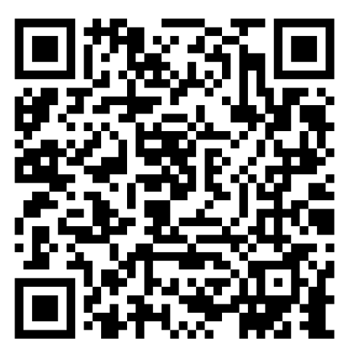
Virtual Input Opportunity
Virtual version of Open House events
Open through June 25
Provide feedback on policy direction via survey
https://planning.virginiabeach.gov/comp-plan/survey

Slide 5
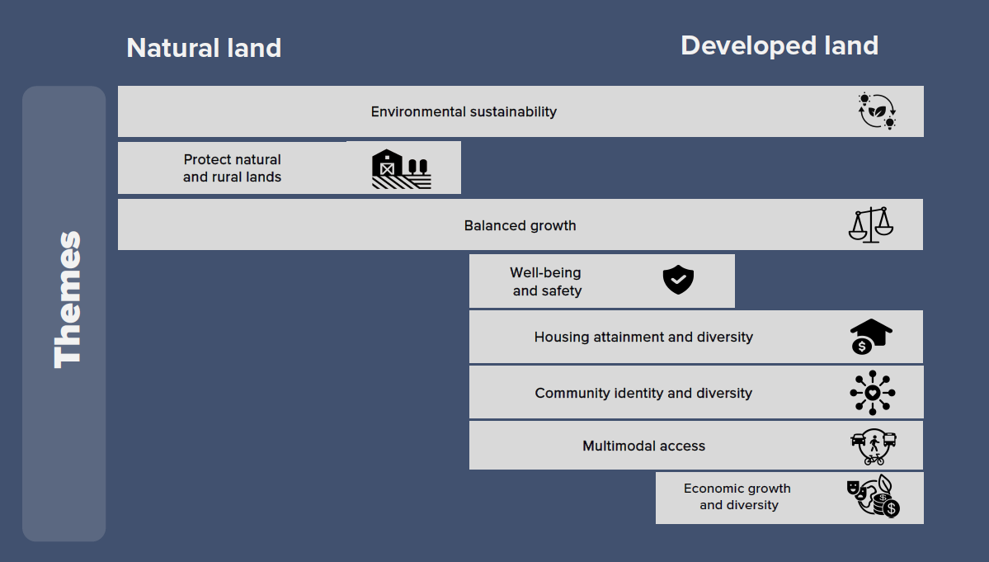
Connecting Themes Across Virginia Beach

Slide 6

Big Ideas
Enhance Natural Areas
Linear Park System
Preserve Rural and Agricultural Land
Multimodal Corridors
Mixed-Use and Walkable Centers
Enhance Community Centers
Neighborhood Walking & Biking Connections
Housing and Neighborhoods
Innovative Businesses & Institutions

Slide 7

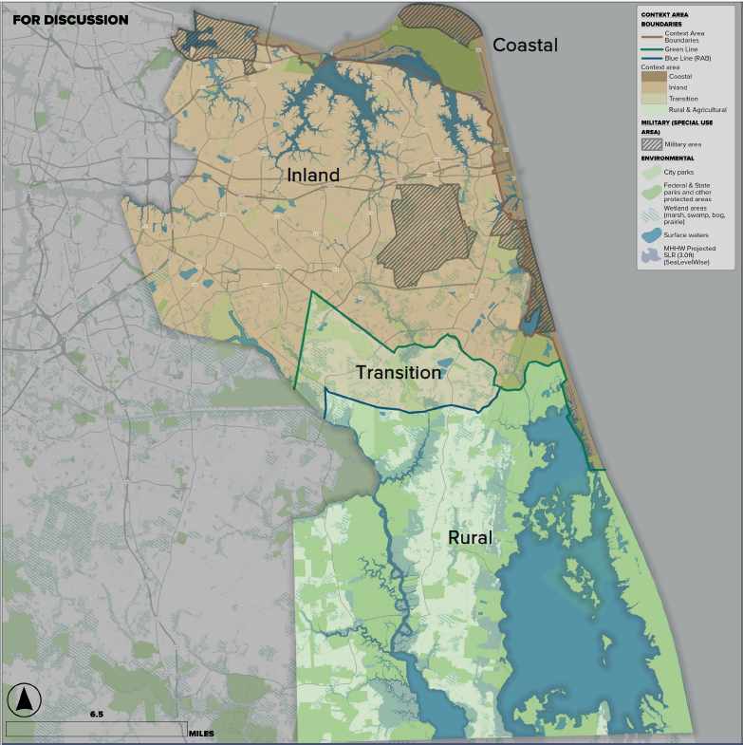
Context Areas
Purpose: Ensure balanced, predictable growth by directing new development north of the Green Line
Rural Context Area: to remain rural and agricultural
Transition Context Area: to remain low intensity development
Inland Context Area: north of the Green Line – absorbs most of the city’s growth as redevelopment within corridors and centers
Coastal Context Area: north of the Green Line and along the coast – would grow to enhance unique coastal character and activities

Slide 8
NEXT STEPS
Staff and consultant will spend the summer drafting Comprehensive Plan document.
Comp Plan draft documents will be reviewed internally by Planning and other departments.
Likely to be future public meetings to present to community
Tentative Adoption: End of 2024
https://planning.virginiabeach.gov/comp-plan/survey

Slide 9


