Slide 1




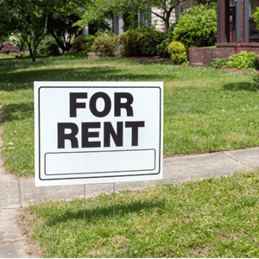
Attainable Workforce Housing Performance Grant Applications
Grand Lake Senior Apartments & The Silo Apartments
Housing & Neighborhood Preservation | VBDA Board: Oct. 14, 2025

Slide 2
Why Are We Here?
Provide Overview:
Housing affordability challenges in Virginia Beach
Attainable Workforce Housing Performance (AWHP) Grant Program and eligibility requirements
AWHP Grant requests for Grand Lake Senior Apartments and The Silo Apartments
Request VBDA Board to authorize VBDA Chair to execute, for and on behalf of the VBDA, the Grant Agreement among the City; VBDA, and Developer

Slide 3
Housing Affordability Challenges in Virginia Beach
  One in three households is housing cost-burdened = About 59,000 spend more than 30% of their income on housing costs
  Median rent in Virginia Beach: $1,730
    Income Needed = About $70,000/year, or $33/hour, full time
Critical concern: Lack of rental units affordable to very-low-income households, many of whom are employed in the region’s top 10 most common occupations.
  Often bear the burden of high housing costs to remain in the city.

Slide 4
New Program to Help Meet the Need
September 2025: Launched Attainable Workforce Housing Performance (AWHP) Grant Program
  City of Virginia Beach and City of Virginia Beach Development Authority (VBDA) partnership
Provides an incentive for private development of safe, quality, affordable multi-family rental housing.
Self-sustaining and performance-based: Annual grants are provided to a developer based on a percentage of the incremental real estate taxes generated by their approved development.
Notes:
Annual Grant Payments are solely limited to the incremental real estate tax revenues generated annually by the project.
Amount to be paid for each year of the Grant Term will be determined annually based on the annual assessed value of the project and the real estate tax rate set by City Council.

Slide 5
Eligibility Requirements
Must be new construction
Must be developed by a for-profit entity
Only new multi-family affordable rental housing units that have not started construction
Applicants must have a demonstrable gap in project financing, as evidenced by their development and operating pro forma
May be fully affordable, mixed-income and mixed-use (commercial and residential components)
Projects that involve the demolition of existing rental housing units are eligible only if they build a minimum of 20% affordable housing units in the new project
Projects should have their zoning approval or are in the process of obtaining approval through the City’s Planning process.

Slide 6
Grant Request 1: Grand Lake Senior Apartments
172 senior housing units (age 62+), 100% residential
Development by Grand Lakes, L.P.; Principal is the Franklin Group Cos.
New construction on vacant land; no other improvements currently on the property
Will be developed using Federal Low-Income Housing Tax Credits (LITHC)
Council approved conditional rezoning: Dec. 10, 2024
Expected to start construction December 2025
Funding gap: $2,150,000

Slide 7
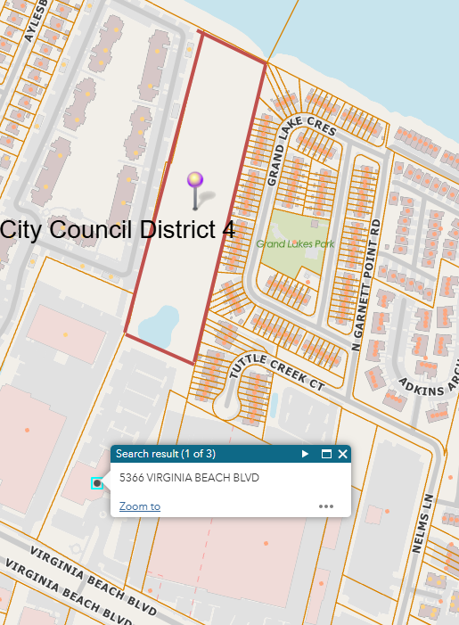
Grand Lake Senior Apartments:
Location and district

Slide 8
Grand Lake Senior Apartments: Affordability
100% (172 units) affordable for households whose incomes are, on average, 60% of Area Median Income (AMI).
89 of the 172 units (about 52%), will serve households at or below 50% AMI.
Developer has also indicated project will provide housing to households with maximum annual gross incomes listed below (based on 2025 HUD published AMI), which are based on household size:
Units | Area Median Income | 1 Person | 2 Person | 3 Person | 4 Person
19 | 30% | $22,380 | $25,560 | $28,770 | $31,950
19 | 40% | $29,840 | $34,080 | $38,360 | $42,600
51 | 50% | $37,300 | $42,600 | $47,950 | $53,250
14 | 60% | $44,760 | $51,120 | $57,540 | $63,900
69 | 80% | $59,680 | $68,160 | $76,720 | $85,200
172

Slide 9
Grand Lake Senior Apartments: Fiscal Impact
First year grant amount: Estimated at $188,503 or $1,096/unit
Estimate is based on recent assessed values of multi-family affordable housing.
  Estimated assessed value of project at completion = $21,278,350
  Estimated 1st year tax revenue is ($21,278,350/$100) * 0.97 = $206,400
  FY 25/26 current assessed value of property = $1,845,000
  FY 25/26 tax revenue is $1,845,000 /$100) * $0.97 = $17,897
  100% of Incremental taxes: $206,400 - $17,897 = $188,503
  Applicant will pay an administrative fee to VBDA of 1% of the annual grant amount
Notes:
Annual Grant Payments are solely limited to the incremental real estate tax revenues generated annually by the project.
Amount to be paid for each year of the Grant Term will be determined annually based on the annual assessed value of the project and the real estate tax rate set by City Council.

Slide 10
Recommended Grant Agreement Terms
Recommend following Grant Agreement terms:
  Base Real Estate Tax amount of $17,897
  Annual Grant payment of 100% of the incremental real estate taxes
  Grant term of 30 years, with 2nd 15 years on condition of capital improvement requirement
  Capital Improvements of $10,000/affordable unit, or $1,720,000 for first 15 years
  Average income of 60% for the grant term (30 years)

Slide 11
Grant Request 2: The Silo Apartments
200 units; 100% residential
Development by The Silo Apts., L.P.; Principal is the Franklin Group Cos.
New construction on vacant land; no other improvements currently on the property
Will be developed using Federal Low Income Housing Tax Credits
Council approved conditional rezoning: July 8, 2025
Expected to start construction June 2026
Funding gap: $2,775,000

Slide 12
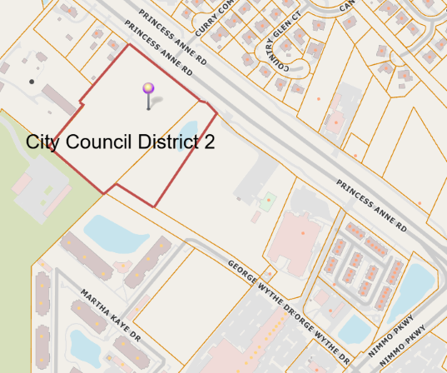
The Silo Apartments
Location and district

Slide 13
The Silo Apartments: Affordability
100% (200 units) affordable for households whose incomes are, on average, 60% of AMI.
Developer has also indicated the project will provide housing for households with incomes at 50% AMI to 80% AMI
Maximum annual gross incomes are listed below (based on 2025 HUD published AMI), which are based on household size:
Area Median Income | 1 Person | 2 Person | 3 Person | 4 Person
50% | $37,300 | $42,600 | $47,950 | $53,250
60% | $44,760 | $51,120 | $57,540 | $63,900
70% | $52,220 | $59,640 | $67,130 | $74,550
80% | $59,680 | $68,160 | $76,720 | $85,200

Slide 14
The Silo Apartments: Fiscal Impact
First year grant amount: Estimated at $216,179 or $1,081/unit
Estimate is based on recent assessed values of multi-family affordable housing.
  Estimated assessed value of project at completion = $27,216,495
  Estimated 1st year tax revenue is ($27,216,495/$100) *0.97 = $264,400
  FY 25/26 current assessed value of property = $4,930,000
  FY 25/26 tax revenue is ($4,930,000/$100) * $0.97 = $47,821
  100% of Incremental taxes: $264,400-$47,821=$216,179
  Applicant will pay an administrative fee to VBDA of 1% of the annual grant amount
Notes:
Annual Grant Payments are solely limited to the incremental real estate tax revenues generated annually by the project.
Amount to be paid for each year of the Grant Term will be determined annually based on the annual assessed value of the project and the real estate tax rate set by City Council.

Slide 15
Recommended Grant Agreement Terms1
Recommend following Grant Agreement terms:
  Base Real Estate Tax amount of $47,821
  Grant payment of 100% of the incremental real estate taxes
  Grant term of 30 years, with 2nd 15 years on condition of capital improvement requirement
  Capital Improvements of $10,000/affordable unit, or $2,000,000 for first 15 years
  Average income of 60% for the grant term (30 years)

Slide 16
Next Steps
City Council Briefing this afternoon: October 14th
City Council Ordinance: October 21st
Comments and questions?

