Slide 1




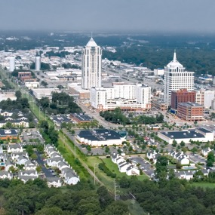

ImagineVB 2040 Comprehensive Plan
Rachael Miller, WEDG
VBDA Retreat, September 6, 2024

Slide 2
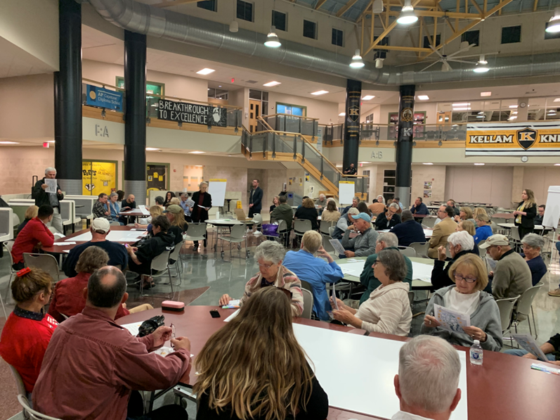
Community Engagement (So Far)
3 Surveys
  9,000 responses
10 focus groups;10 public meetings
  1,500 participants
65 total stakeholder meetings attended by staff
What Staff Heard:
Be a city where people want to stay a lifetime
Balanced Growth
  Protect established neighborhoods
  Appropriate infill and redevelopment
  Maintain the Green Line
  Identify areas for Economic Development
Resiliency – environmental, social, and economic
Ability to walk, bike, drive, or use transit safely and efficiently

Slide 3
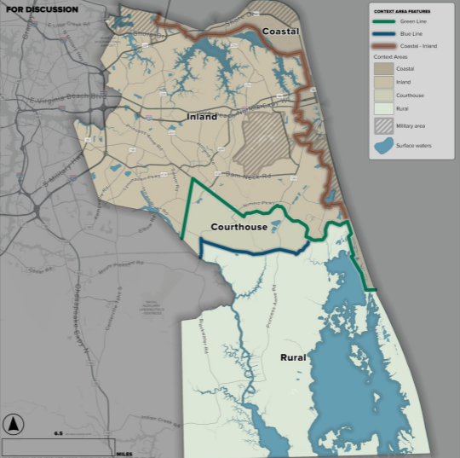
Context Areas
Notes:
Will either be Courthouse Context Area (historically this area was called the Courthouse/Sandbridge Planning Area from 1979-2003) or the Transition Context Area.

Slide 4
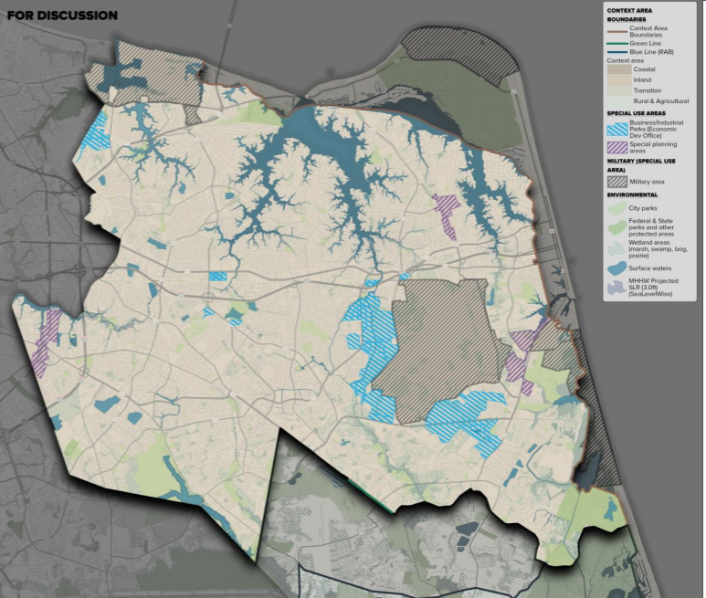
Planning Areas & Districts
Notes:
Formerly special economic growth areas (blue), suburban focus areas (purple) – includes Princess Anne Commons and the ITA

Slide 5
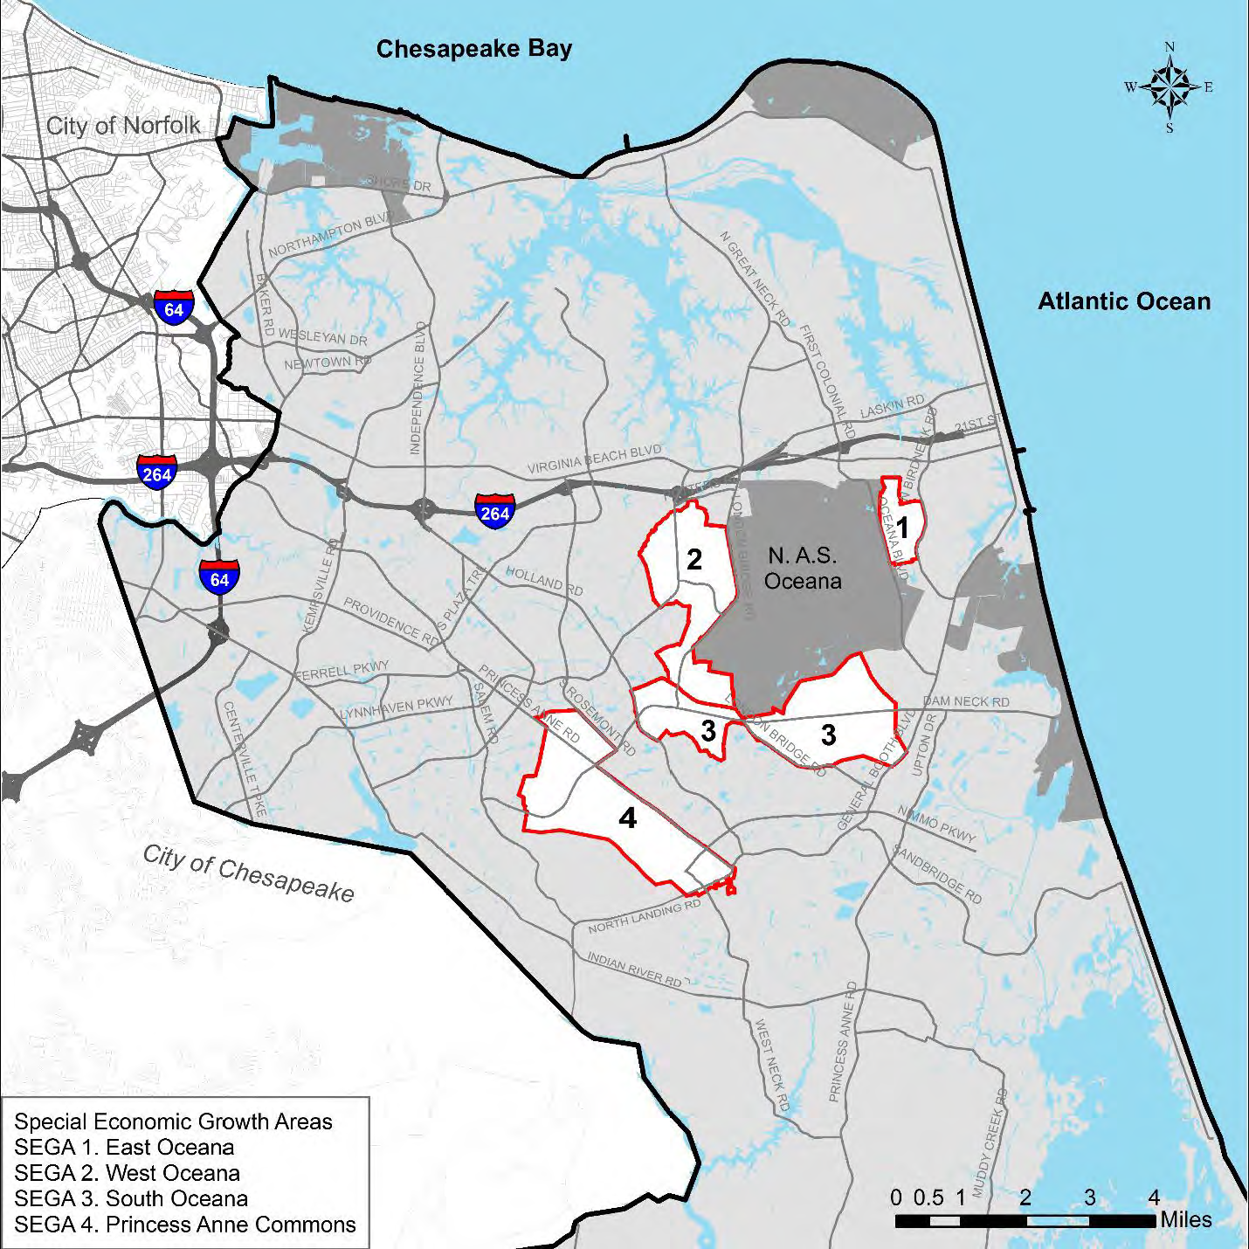
Special Economic Growth Areas (SEGAs)
Notes:
Formerly special economic growth areas (blue), suburban focus areas (purple) – includes Princess Anne Commons and the ITA

Slide 6
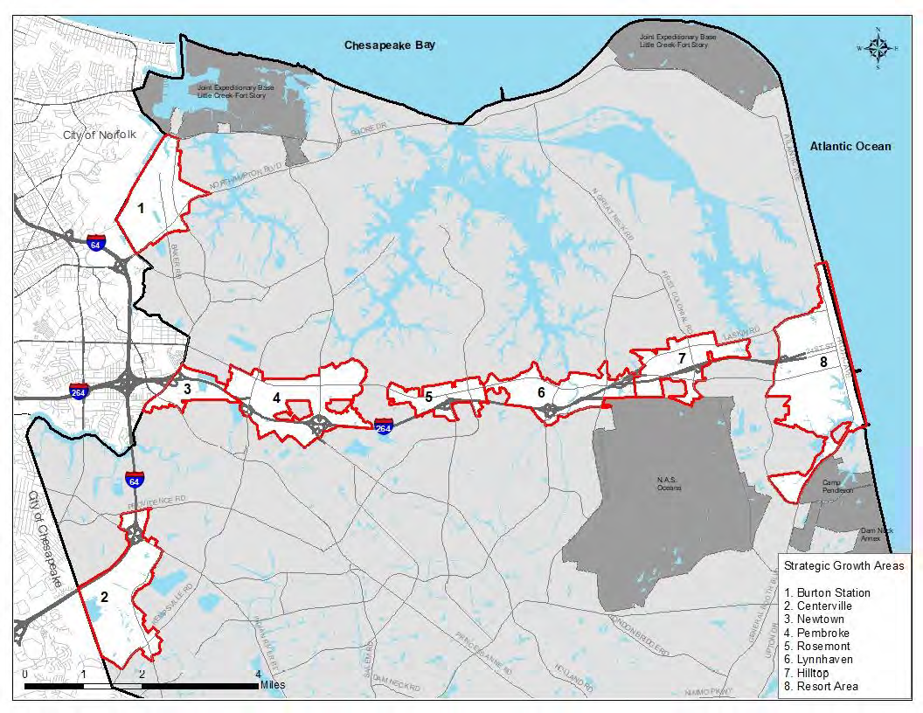
Strategic Growth Areas (SGAs)
Notes:
Formerly special economic growth areas (blue), suburban focus areas (purple) – includes Princess Anne Commons and the ITA

Slide 7
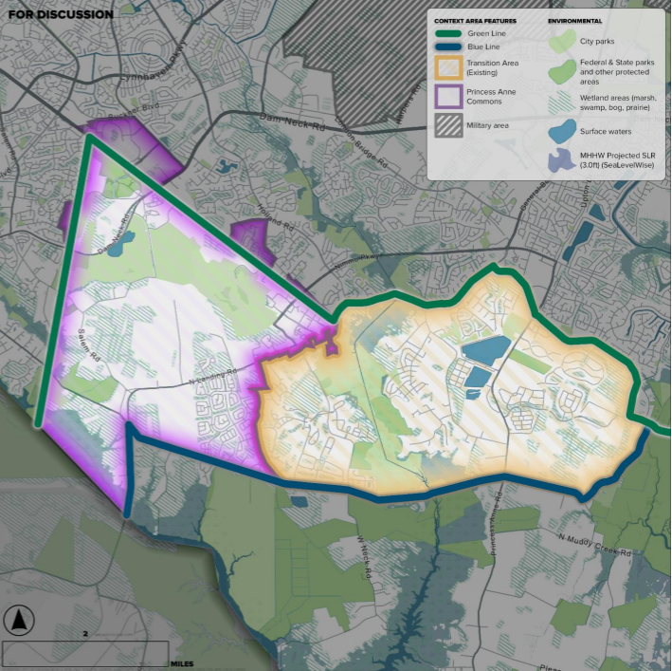
Transition/Courthouse Context
Area
Notes:
PA Commons has historically been designated for economic development activities, in compliance with AICUZ and ITA Zoning Overlay

Slide 8
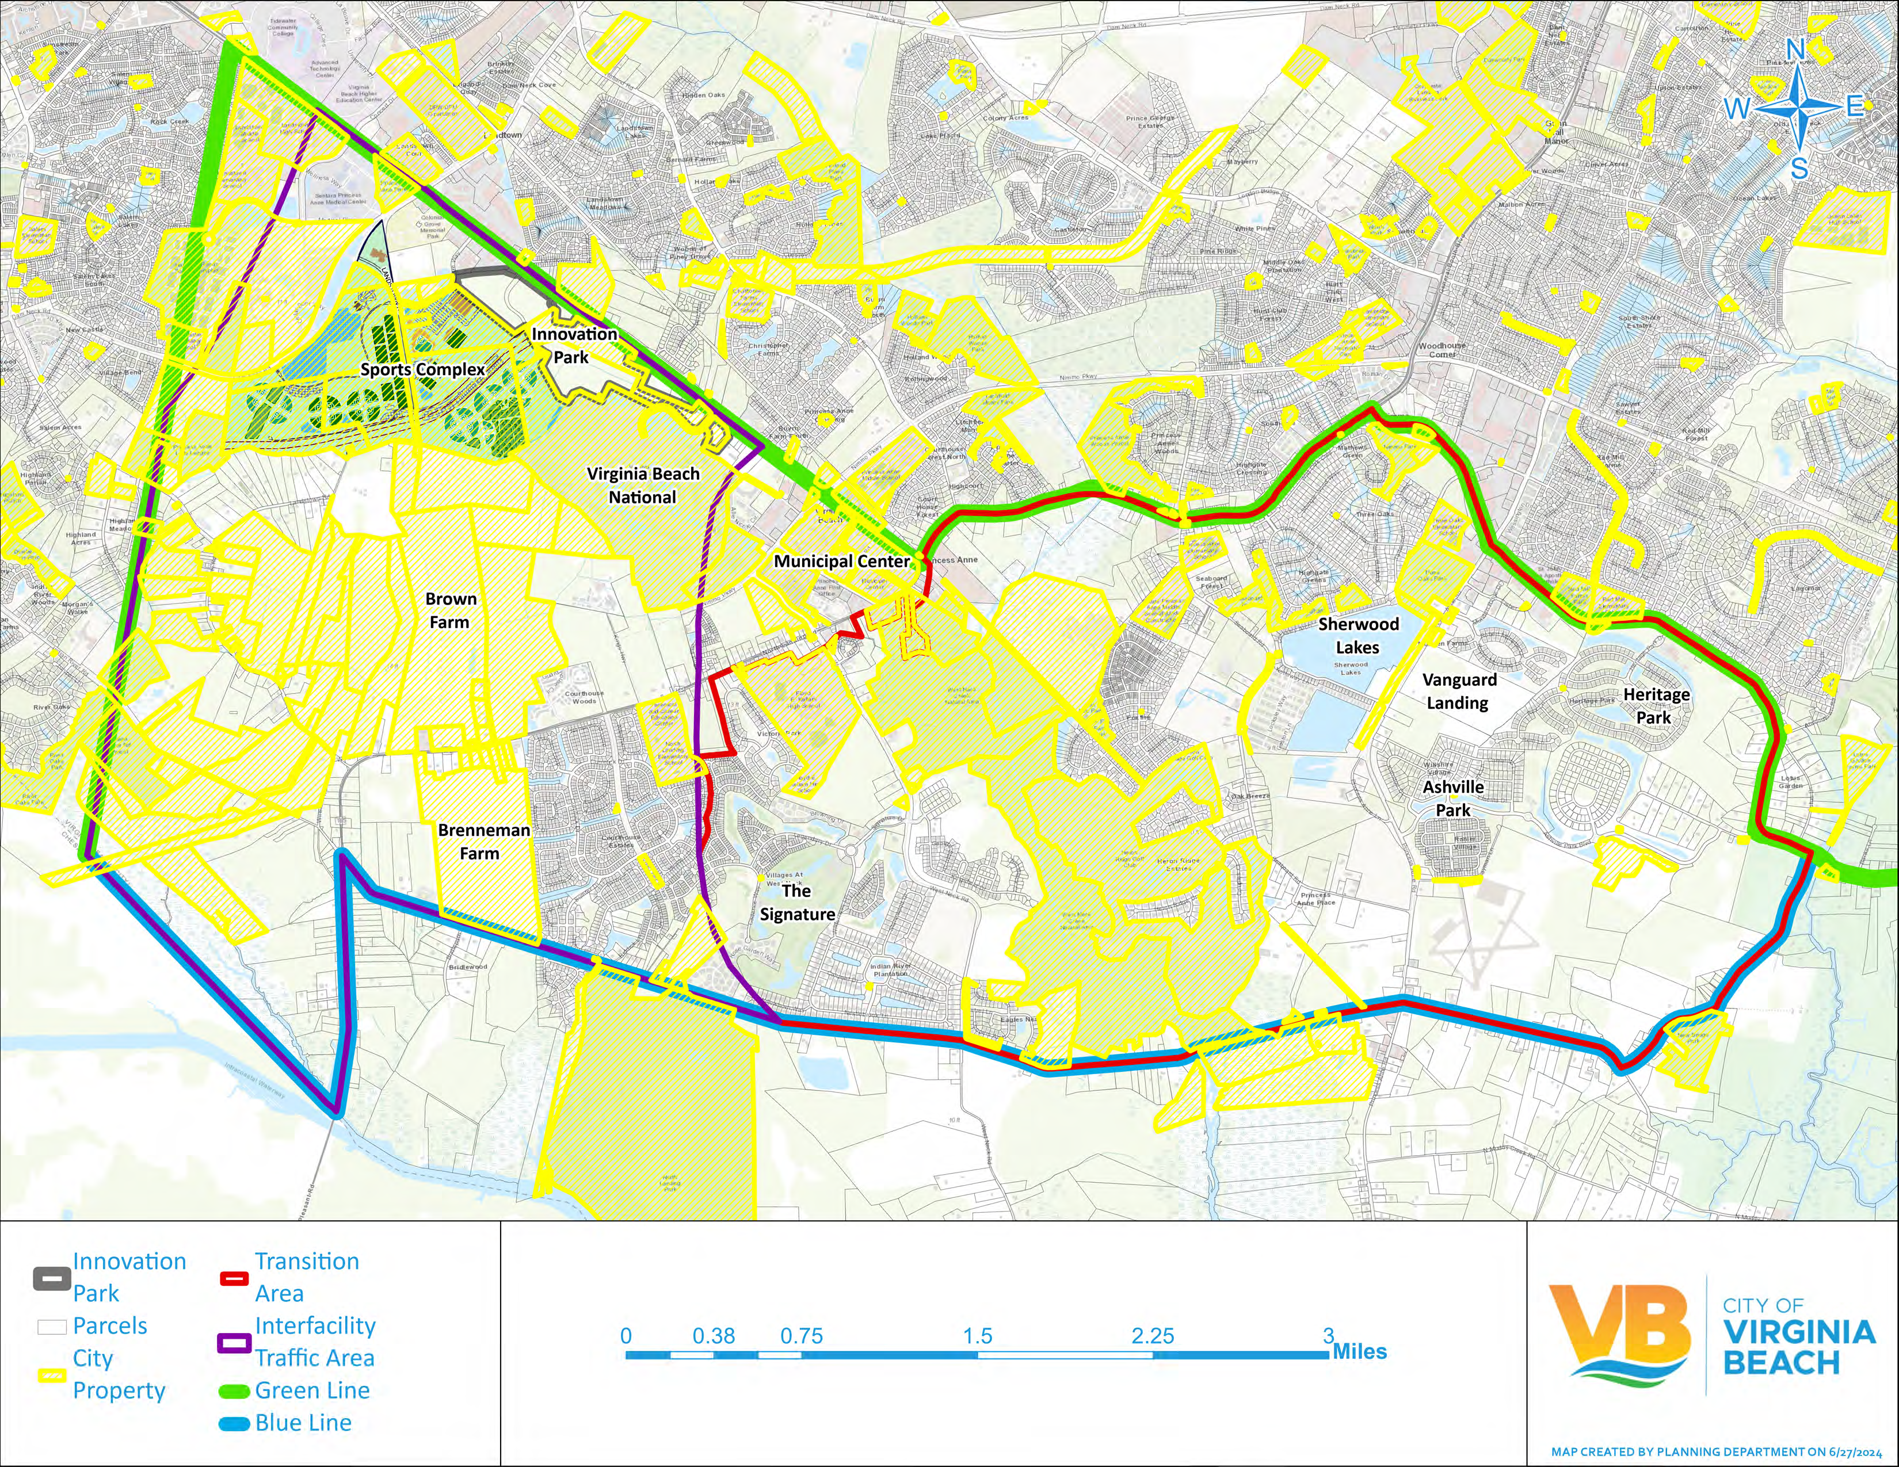
Transition/
Courthouse Context Area & Economic Development Opportunities
Notes:
PA Commons has historically been designated for economic development activities, in compliance with AICUZ and ITA Zoning Overlay

Slide 9
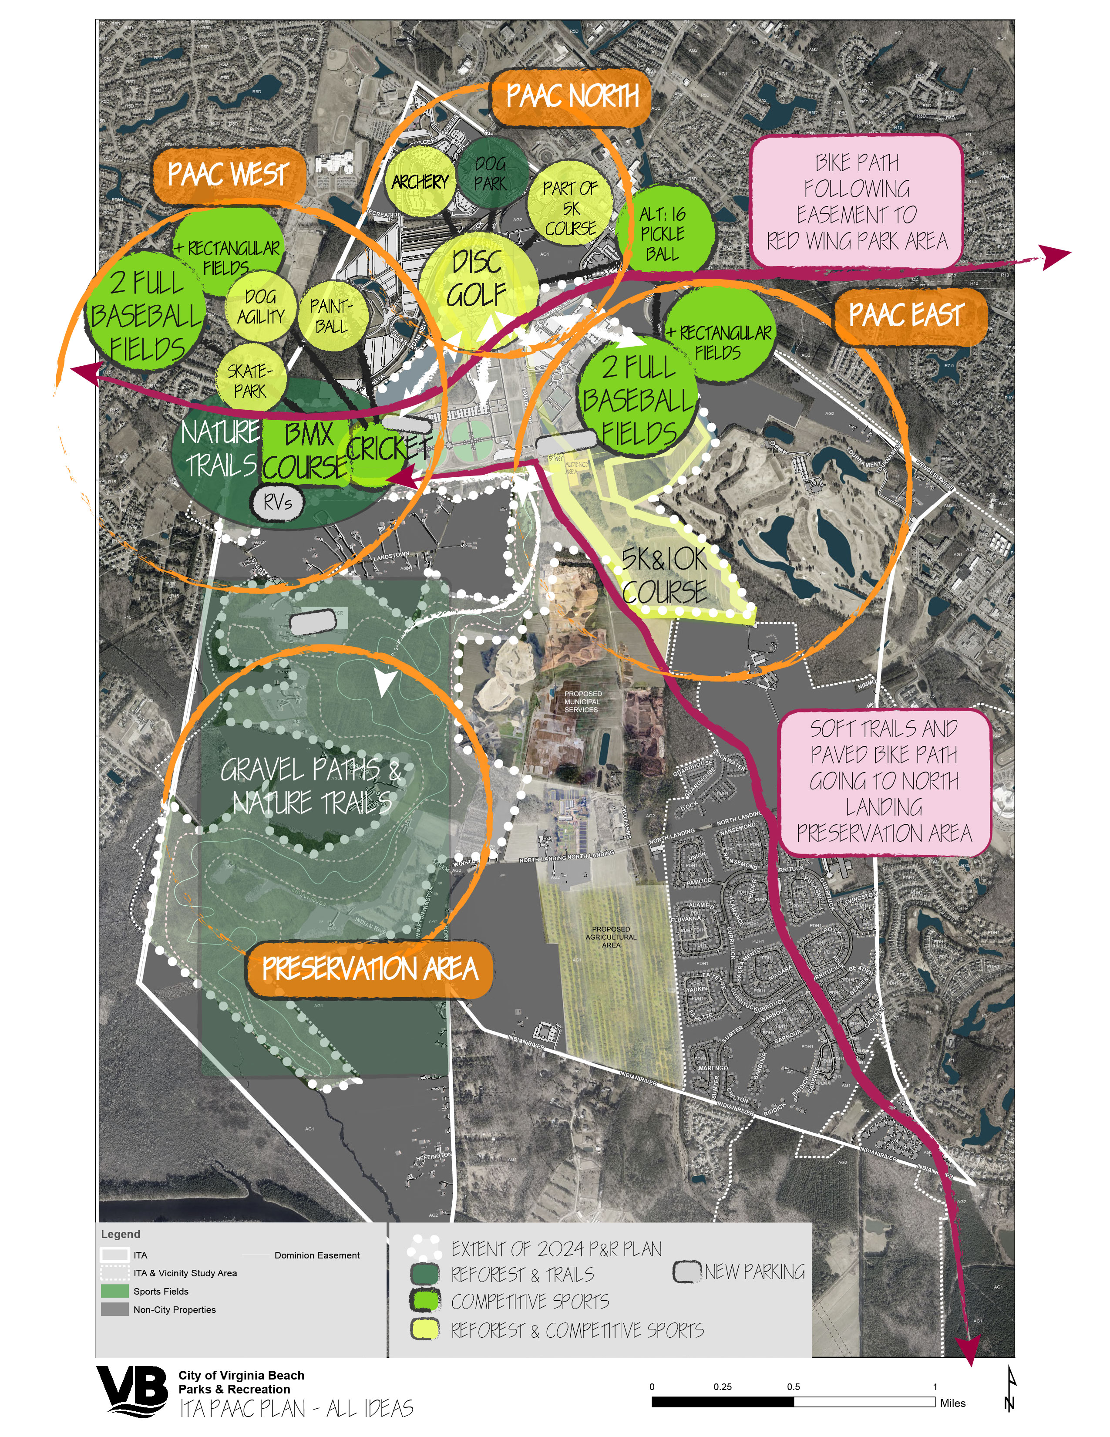
ITA Princess Anne Athletic Complex Plan:
Stakeholder Ideas
Notes:
PA Commons has historically been designated for economic development activities, in compliance with AICUZ and ITA Zoning Overlay

Slide 10
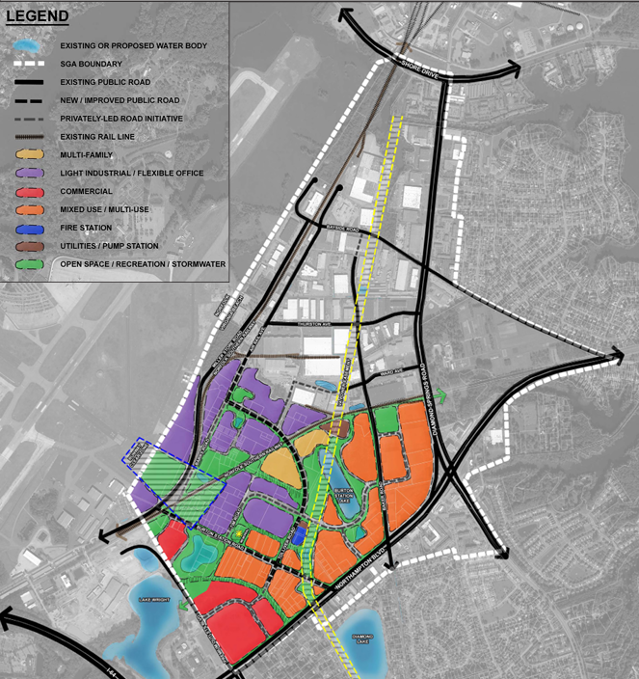
Burton Station SGA Master Plan
Notes:
ORF runway clear zone has been removed, opening up new industrial opportunities in Burton Station SGA

Slide 11
Next Steps
Staff and consultant are currently drafting Comprehensive Plan document.
A preliminary draft is expected to be available in early fall (September/October).
Comp Plan draft documents will be reviewed internally by Planning and other departments, then by community .
A workshop with the Planning Commission will be scheduled when a draft is prepared.
Targeted Time of Adoption: Early 2025

Slide 12

Thank you
Project Manager:
Hank Morrison, AICP, CZA
757-385-4319
Jmorrison@vbgov.com
CompPlan@vbgov.com

