Slide 1

Protecting Yourself from Scams and Cybersecurity Threats
Practical Tips for Everyday Safety
Rick Boyles
Cybersecurity Expert
President
Virginia Beach Council of Civic Organizations

Slide 2

Why This Matters
Scams and cyber threats are widespread.
Over $12.5 billion lost to scams in 2023 (FBI Internet Crime Report).
Financial and emotional impacts can be devastating.
Staying informed is essential to protect yourself.

Slide 3
Definitions
Phishing - Phishing is a scam that uses fake emails to try and steal your personal information.
Spearphishing –Targets one person (or company) in particular.
BEC/CEO Fraud - CEO fraud is a kind of spear-phishing that targets specific people, usually by spoofing high-profile or wealthy individuals. Asking staff to buy Amazon Gift Cards.
SMiShing - The criminal sends you a text message.
Malware - Malicious software generally delivered via email of through a screen pop-up.

Slide 4
Types of Scams to Watch For
**Phone Scams** IRS impersonation claiming back taxes owed.
**Email Phishing** Fake PayPal notice asking to verify account.
**Online Shopping Scams**
Counterfeit goods sold on social media.
**Romance Scams** Fraudulent dating profiles requesting money.
**Investment Scams** 'Guaranteed' returns in cryptocurrency.

Slide 5
Types of Scams to Watch For
1. Tech Support Scams
Scammers pose as technology support representatives, claiming the victim's computer has issues that need fixing. They gain remote access to the device and may install malware or steal personal information. Victims are then charged for unnecessary or fraudulent services. WIKIPEDIA
2. Grandparent Scams
Fraudsters impersonate a grandchild in distress, often claiming to be in legal trouble or stranded, and urgently request money. The emotional manipulation leads grandparents to act quickly without verifying the caller's identity. ARXIV

Slide 6
Types of Scams to Watch For
3. Romance Scams
Scammers create fake profiles on dating sites or social media to establish romantic relationships with seniors. Once trust is built, they fabricate emergencies or investment opportunities to solicit money. For example, a 68-year-old woman was conned out of hundreds of thousands of dollars over seven years by a man claiming to be a U.S. soldier. THE SUN
4. Investment Scams
Seniors are lured into fraudulent investment schemes promising high returns with little risk. These can include Ponzi schemes, fake bonds, or real estate scams. In Australia, a family lost $1.1 million in a sophisticated bond investment scam involving major banks. NEWS.COM.AU

Slide 7
Types of Scams to Watch For
5. Lottery and Sweepstakes Scams
Victims receive notifications claiming they've won a lottery or sweepstakes but must pay fees or taxes upfront to claim the prize. After payment, the prize never materializes. MONEY Magazine
6. Bitcoin ATM Scams
Scammers instruct victims to withdraw cash and deposit it into a Bitcoin ATM, often under the guise of protecting their assets from fraud. In 2023, senior citizens lost $110 million to such scams, a tenfold increase from 2020. NEW YORK POST

Slide 8
Types of Scams to Watch For
7. Medical Alert Scams
Seniors are told they've been signed up for a free medical alert system, but to receive it, they must provide personal and financial information, leading to unauthorized charges. WIKIPEDIA
8. Charity Scams
Fraudsters pose as representatives of fake charities, especially after natural disasters or during holidays, soliciting donations from well-meaning seniors. MONEY

Slide 9
Protect yourself
Protective Measures:
Verify Identities: Always confirm the identity of individuals requesting money or personal information, especially if contacted unexpectedly.
Avoid Unsolicited Offers: Be cautious of unsolicited calls, emails, or messages offering services or requesting donations.
Consult Trusted Sources: Discuss financial decisions with trusted family members or advisors before taking action.
Report Suspicious Activity: Contact local law enforcement or consumer protection agencies if you suspect a scam.
Staying informed and vigilant is crucial in protecting oneself from these deceptive practices.

Slide 10
How to Spot a Scam
Urgent action requests (e.g., “Pay now or lose access”).
Unsolicited offers or prize notifications (1 in 4 adults targeted annually).
Payment requests via gift cards or wire transfers.
Grammar or spelling errors (75% of phishing emails).
Spoofed caller IDs or fake websites (Over 40% of scams in 2022).

Slide 11
Email Phishing Example
Subject: "Your Account Is Locked! Immediate Action Required"
Body: "Dear Valued Customer,
We noticed suspicious activity in your account and have temporarily locked it to protect you. Please confirm your account details to regain access.
Click here to verify your account: [malicious-link.com]
Failure to do so within 24 hours will result in permanent suspension.
Thank you for your prompt attention.
Customer Support Team"
Red Flags:
Sense of urgency.
Generic greeting instead of your name.
Link to an unknown website.

Slide 12
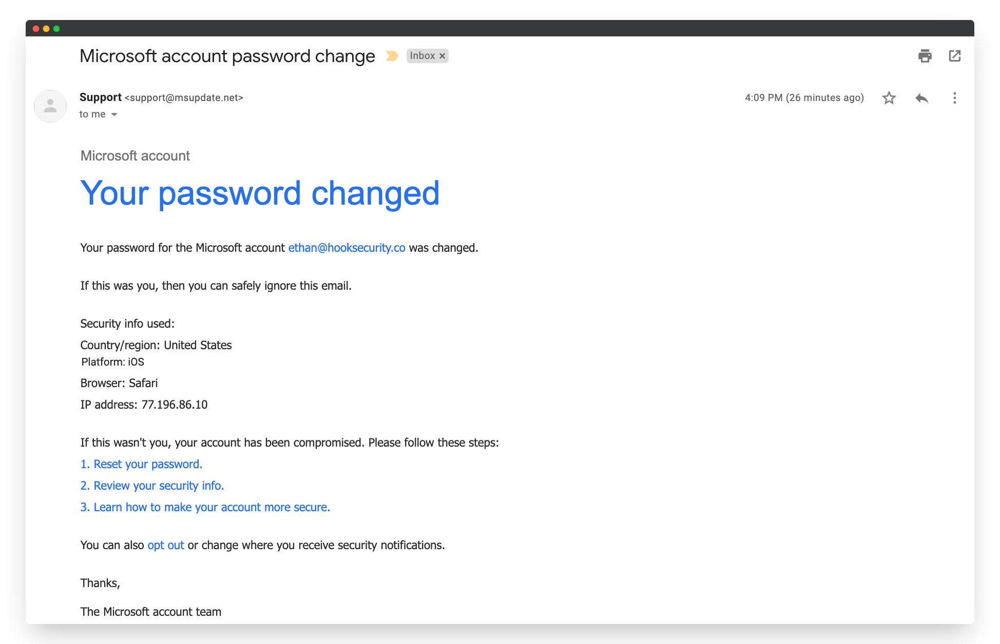
Email Phishing Example

Slide 13
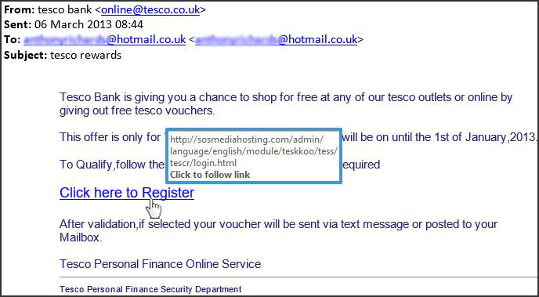
Email Phishing Example

Slide 14
Text Message Scam Example
Message: "Amazon: Your package delivery failed. Update your shipping info to avoid return: [bit.ly/fake-link]"
Red Flags:
Shortened URL.
Unsolicited message when you’re not expecting a package.
Poor grammar or unusual phrasing.

Slide 15
Phone Call Scam Example
Caller Script: "Hello, this is Officer Miller from the Social Security Administration. We’ve detected suspicious activity on your Social Security number and need you to verify your details immediately. Failure to do so will result in suspension of your number. Press 1 to speak with an officer."
Red Flags:
Threat of immediate action.
Claiming to be from a government agency.
Request for personal information over the phone.

Slide 16
Fake Invoice Email Scam
Subject: "Invoice #56789 Due Immediately"
Body: "Hello,
Attached is your invoice for $1,200. Please make payment within 48 hours to avoid late fees.
[Attachment: Malicious PDF]
Thank you for your business.
Accounts Team"
Red Flags:
Unexpected invoice.
Attachment that could contain malware.
No specific details about the service or purchase.

Slide 17
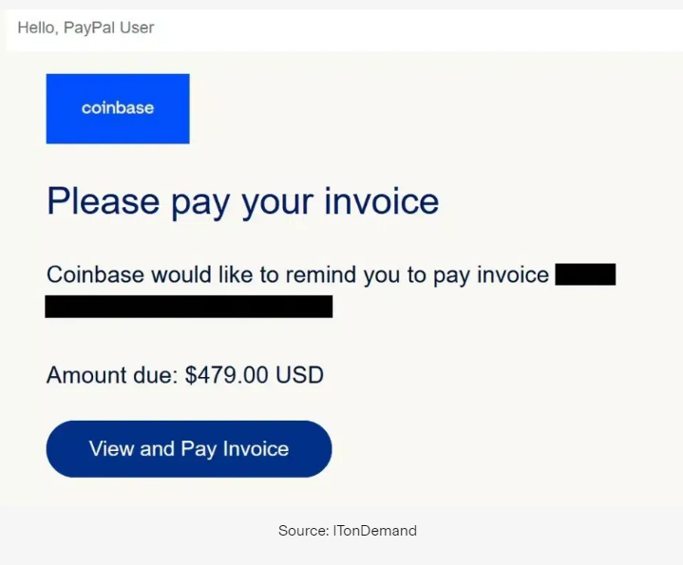
Fake Invoice Email Scam

Slide 18
Romance Scam Example
Message on a Dating App: "Hi, I’m Alex. I’ve been stationed overseas, and I really feel like we’ve connected. My deployment is ending soon, but I need help covering travel expenses to see you. Can you send $500? I’ll pay you back as soon as I return."
Red Flags:
Request for money from someone you’ve never met in person.
Overly emotional or rushed tone.

Slide 19
Tech Support Scam Pop-Up Example
Pop-Up Message on Computer: "WARNING! Your computer has been infected with a virus. Call Microsoft Support immediately at 1-800-FAKE-NUMBER to resolve the issue. Failure to act may result in data loss."
Red Flags:
Pop-up claiming to be from a legitimate company.
Request to call a number or pay for support.
Threats of data loss or immediate action required.

Slide 20
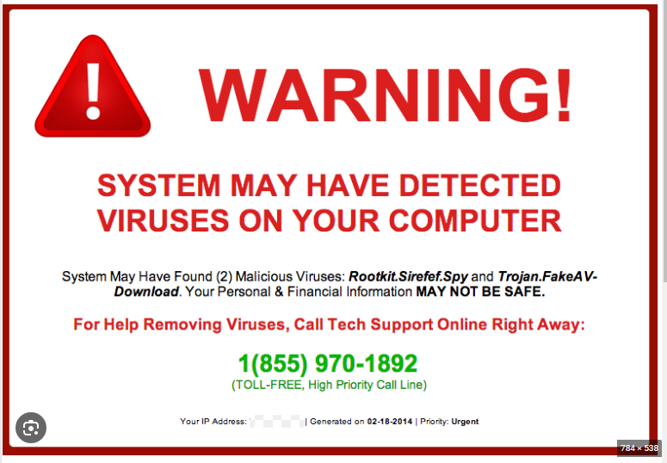
Tech Support Scam Pop-Up Example

Slide 21
Lottery Scam Email Example
Subject: "Congratulations! You’ve Won the International Lottery"
Body: "Dear Winner,
Congratulations! Your email was randomly selected as the winner of $1,000,000 in the International Lottery. To claim your prize, please provide your full name, address, phone number, and banking details.
We look forward to hearing from you soon.
International Lottery Team"
Red Flags:
Unsolicited notification about winning a lottery you didn’t enter.
Request for personal and banking information.

Slide 22
Fake Charity Call Example
Caller Script: "Hi, this is Sarah from Children’s Hope Foundation. We’re raising funds to help children affected by recent disasters. Can I count on you for a $100 donation today?"
Red Flags:
Pressure to donate immediately.
Vague or unfamiliar charity name.
Caller refuses to provide detailed information or verification.

Slide 23
VA Beach Sheriff’s Office
SCAM ALERT:
A common scam right now involves a scammer approaching a victim to ask for monetary assistance. Usually, they will tell the victim that they can’t access their own bank account and only need a very small amount of money for something – gas, staple groceries, etc.
They will ask the victim to log into their bank account and then have the victim will hand their phone over to the scammer to make the money transfer.

Slide 24
VA Beach Sheriff’s Office
The scammer transfers a minimal amount to a bogus account AND transfers additional money into a different account. The scammer will then show the victim the first transfer (the victim thinks it’s legit), not realizing they’ve been scammed.
Don’t fall for this scam! If you want to help those in need, donate through a reputable charity.
For more information on scams and how to protect yourself, visit https://vbso.net/consumer-protection-unit .

Slide 25
VA Beach Sheriff’s Office
Scam Alert❗️ Scammers are calling people whose loved one has been recently convicted of a crime and falsely representing the Virginia Beach Sheriff's Office by saying the family can pay a certain amount of money (in the hundreds) for an ankle monitor so the loved one can serve time outside of the jail at home.
This is a SCAM! The VBSO will never ask you for money over the phone OR offer a conviction deal over the phone. We do not handle that aspect of the court system.
Hang up and let our Consumer Protection Unit know at 757-385-7922 or https://vbso.net/consumer-protection-unit .

Slide 26

VA Beach Police Citizens advisory Committee (CAC)
All,
I just received a notice of an email hacking that I suspect came from this account. I have changed my password and enabled 2-factor verification.
Please beware. Only money I have sought was back in November and that was for donations to CAC General Fund- not gift cards or donations in kind.
If you get any suspected emails from me, please capture the originating email address by hovering over the sender's name and letting me know.
Thank you and I apologize for not practicing what I preach.
Regards,
M. C. "Connie" Agresti

Slide 27
Keeping Your Digital Life Safe
**Strong Passwords**: Avoid 'password123'; use phrases like 'GreenApples2024!'
**Two-Factor Authentication (2FA)**: Text codes or authenticator apps
**Keep Updated**: Install security patches promptly (71% of attacks exploit old vulnerabilities)
**Avoid Public Wi-Fi**: Use VPNs for secure browsing

Slide 28
Safeguard Your Data
Avoid oversharing on social media (e.g., birthday, address).
1
Monitor financial accounts for unauthorized charges.
2
Shred documents like bank statements or medical bills before discarding.
3

Slide 29
Safeguard Your Data
If you use social media, remember not to answer “friendly" inquiries or play online games that ask questions such as:
what town did you grow up in
what was the make of your first car
who was your 1st-grade teacher
what was your favorite subject in school
who was your favorite childhood friend
what type of animal was your first pet
what was the first concert you attended
what school did you attend in the 6th grade
and so on and so forth

Slide 30
Safeguard Your Data
These are all security questions!
The answers to which can enable someone to compromise your account. Remember as well, when you set-up the answers to these questions on legitimate websites, your answers need not be accurate or truthful. All that matters is that you remember what you write for an answer - just don't make it too common or easy to guess.

Slide 31
Safeguard Your Data
What can I do to protect myself?
1. Use Strong, Unique Passwords
Create passwords with a mix of letters, numbers, and special characters.
Use a unique password for each account.
Consider using a password manager software program.
2. Enable Two-Factor Authentication (2FA)
Add an extra layer of security by requiring a code sent to your phone or email in addition to your password.
3. Keep Software Updated
Regularly update your operating system, browser, and software to fix security vulnerabilities.
Enable automatic updates when possible.
4. Install and Use Antivirus Software
Use reputable antivirus software to protect against malware.
Keep the antivirus software updated.

Slide 32
Safeguard Your Data
What can I do to protect myself?
5. Use a Firewall
Ensure your computer’s firewall is enabled.
Use a router with a built-in firewall for added protection.
6. Be Cautious with Emails and Links
Avoid clicking on links or downloading attachments from unknown or suspicious sources.
Verify email senders if the message seems unusual.
7. Use Secure Networks
Avoid using public Wi-Fi for sensitive activities like banking.
Use a Virtual Private Network (VPN) when accessing public or unsecured networks.
8. Practice Safe Browsing
Stick to reputable websites.
Look for “https://” and a padlock icon in the browser address bar when entering sensitive information.

Slide 33
Safeguard Your Data
What can I do to protect myself?
9. Limit Sharing Personal Information
Be mindful of the personal details you share online.
Review privacy settings on social media and limit what others can see.
10. Regularly Back Up Data
Back up important files to an external drive or secure cloud storage.
Schedule automatic backups to ensure data is regularly saved.
11. Be Aware of Phishing Scams
Watch for unsolicited messages asking for personal information.
Learn to recognize common phishing tactics.
12. Use Strong Encryption
Encrypt sensitive files on your computer and external drives.
Use encrypted messaging apps for private communications.

Slide 34
Safeguard Your Data
What can I do to protect myself?
13. Monitor Financial Statements and Accounts
Regularly review bank and credit card statements for suspicious activity.
Set up account alerts for transactions.
14. Secure IoT Devices
Change default passwords on smart devices.
Keep firmware updated on connected devices.
15. Log Out After Use
Always log out of accounts when finished, especially on shared or public devices.
16. Educate Yourself and Others
Stay informed about the latest online threats and security practices.
Share knowledge with family and friends to help them stay safe too.

Slide 35
Safeguard Your Data
What can I do to protect myself?
17. Limit Administrator Rights
Use a standard user account for everyday activities.
Reserve administrator rights for software installation and system changes.
18. Avoid Unknown USB Devices
Do not plug in USB drives from untrusted sources, as they can carry malware.

Slide 36
Responding to a Scam or Cyber Attack
**Reporting**:
File complaints with FTC, IC3 (Internet Crime Complaint Center), and local authorities.
01
**Immediate Action**:
Notify your bank or credit card company within 24 hours of fraud.
02
**Freezing Credit**:
Contact Experian, TransUnion, and Equifax.
03
**Password Reset**:
Use secure recovery options for accounts then change password and add MFA (Multi-Factor Authentication)
04

Slide 37

Where to Get Help
Consumer Protection Unit
https://vbso.net/consumer-protection-unit

Slide 38
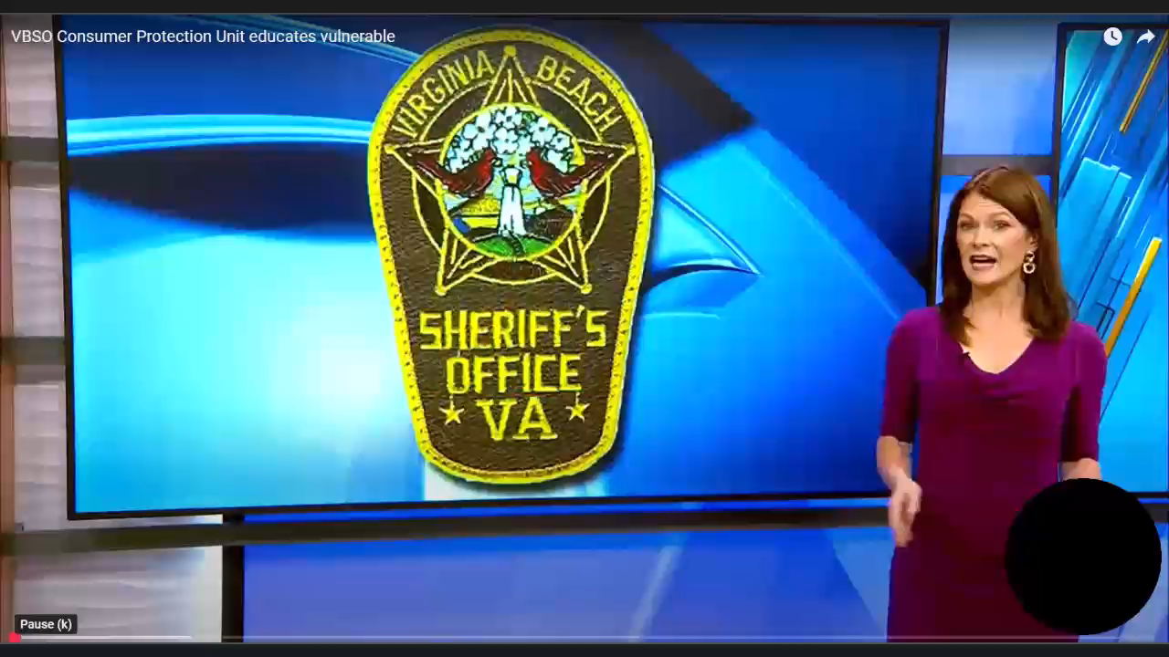
Where to Get Help

Slide 39
Where to Get Help
Federal Trade Commission (FTC): www.ftc.gov
Better Business Bureau (BBB): www.bbb.org
Local law enforcement contacts.
Cybersecurity resources like haveibeenpwned.com.

Slide 40
Where to Get Help
https://consumer.ftc.gov/articles/how-recognize-and-avoid-phishing-scams
https://www.identitytheft.gov/Info-Lost-or-Stolen
https://reportfraud.ftc.gov/
https://vbso.net/consumer-protection-unit

Slide 41
Stay Informed, Stay Safe
Recognize, Protect, Report.
Share this knowledge with family and friends.
Thank you for your attention.

Slide 42

QuestIons?
Rick Boyles, President
president@vbcco.org
Virginia Beach Council of Civic Organizations

