Slide 1


Virginia Beach Council of Civic Organizations
Session 2: City Council Agenda Review & Civic Process
Presented by:
Hon. Chris Taylor
1/29/26

Slide 2
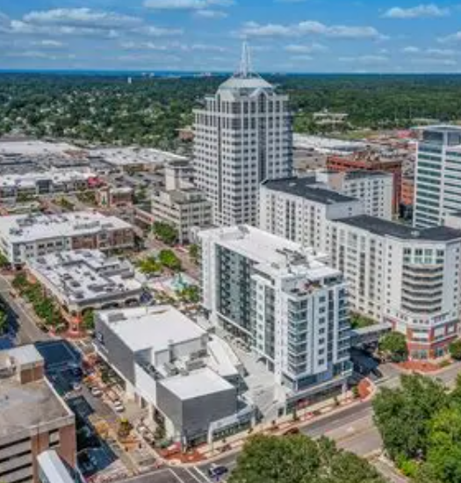
Mission Statement
To create a forum whereby the Civic Organizations throughout the city can work together to educate, inform, and empower civic leaders, support and assist member organizations, and advocate for stronger neighborhoods.
To help organize neighborhood Civic Organizations and to support the activities of member organizations when requested.
To develop and approve city-wide Resolutions reflecting the VBCCO's position or recommendation.
To study and discuss community issues and work toward solutions.
To provide a forum for the discussion and debate of current topics and to provide educational programs that will enable member organizations to better serve their residents.

Slide 3
Why VBCCO Matters to Neighborhoods
Education
Empowerment
Advocacy
Collaboration

Slide 4
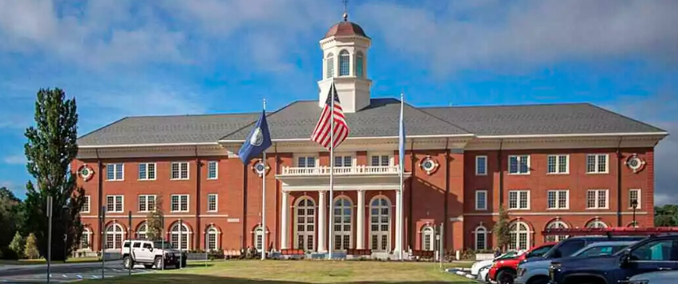
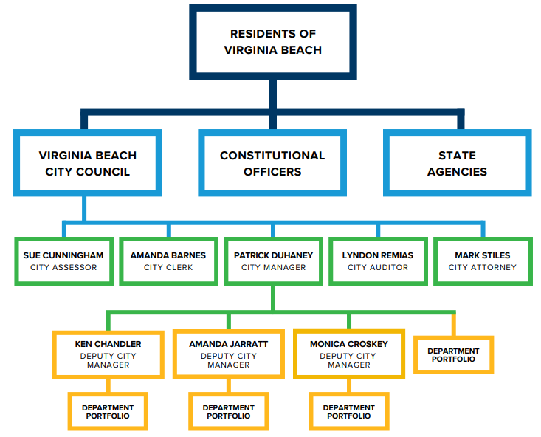
Understanding How the City Is Organized
Helps residents know where decisions are made.

Slide 5
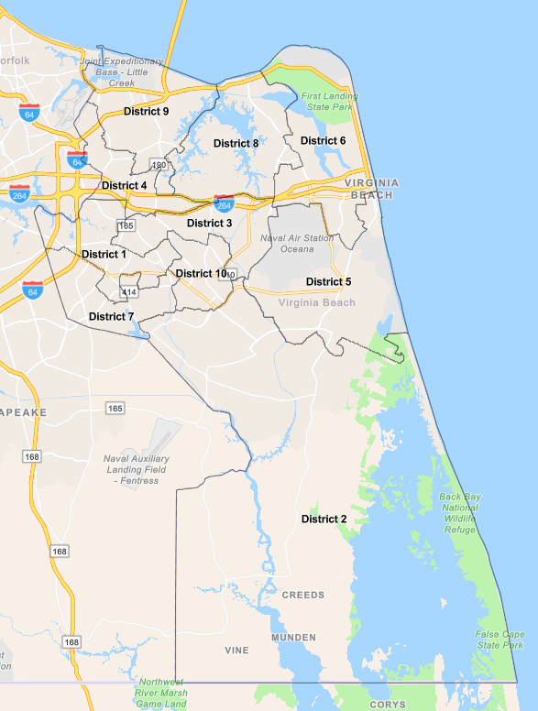
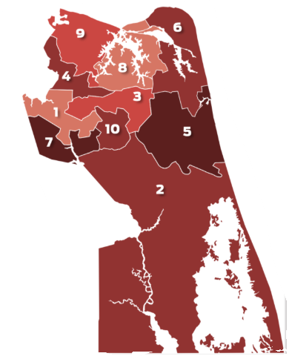
Virginia Beach Voting Districts
Know Your District
Know Your Representative
Engage at the Right Level

Slide 6
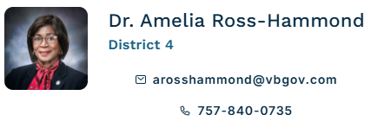
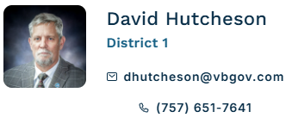
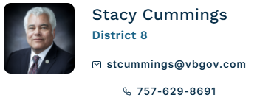
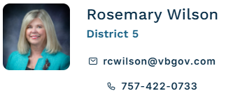
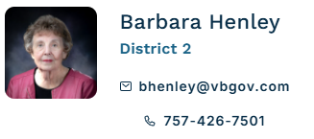
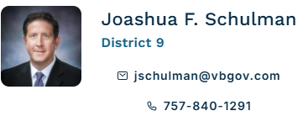
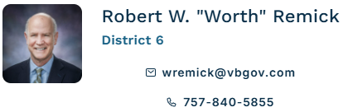
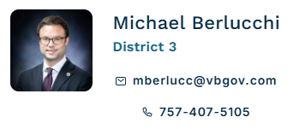
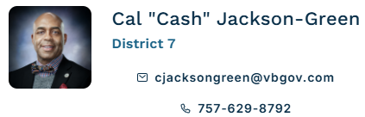
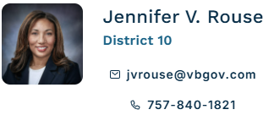
Virginia Beach City Council Members
Council Members are policy makers, not day-to-day administrators.

Slide 7
Who To Contact
Policy vs. Operations
Mayor
Bobby Dyer 757-385-4581 MayorsOffice@vbgov.com
The Mayor of Virginia Beach is the head of the municipal government in Virginia Beach, Virginia, which has a council-manager system of government. The mayor presides over city council meetings and serves as the ceremonial head and spokesperson of the city.
City Manager
Patrick A. Duhaney 757-385-4242 CMOffice@vbgov.com
The office provides support and direction for the delivery of quality customer service to Virginia Beach residents and visitors, the City Council, City Staff, and others, to maintain and nurture a quality community
City Clerk
Amanda Barnes MMC 757-385-4303 ABarnes@vbgov.com
The office of the city clerk preserves and provides accurate legislative historical records for the Virginia Beach City Council.

Slide 8
Who To Contact
Policy vs. Operations
City Attorney
Mark D. Stiles 757-385-4531
The City Attorney’s office provides effective, efficient legal services, promoting accountability, trust, and openness in government, and focus on outcomes that are fair, equitable, and balanced
City Auditor
Lyndon S. Remias, CPA, CIA 757-385-5870 lRemias@vbgov.com
To promote accountability and integrity in city operations by providing quality audit services
Real Estate Assessor
Departments 757-385-4601 Assessor@vbgov.com
The office of the Real Estate Assessor is to annually value all real estate in the city of Virginia Beach with fairness and equity, in compliance with the Virginia State Law and Virginia Beach City Code.

Slide 9
THE POWER OF COMMUNICATION

Slide 10

Definition of Civility:
Showing respect for others in what you say and do.
Definition of Respect:
Recognizing the dignity, rights, and contributions.

Slide 11
Communicating With Municipal Management
Be prepared to address the topic.
Approach the situation with professionalism.
Clearly articulate your point.

Slide 12
Communicating With Elected Officials
Be respectful when engaging.
Early outreach is essential.
Understanding the agenda is essential to effective communication.

Slide 13
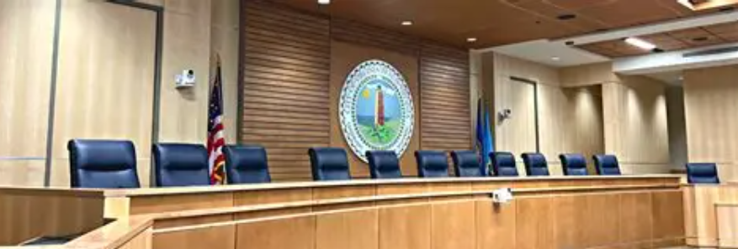
Session 1 Review:
Applying Civility & Communication
Hierarchy
Role of Management
Resolving issues

Slide 14
Defining The Agenda
IMPORTANT!
If it’s not on the agenda, it is not ready for action.
Official list of items Council may discuss or act upon.
Prepared in advance and publicly posted.
Governs Council action.

Slide 15
How Items Get On The Agenda (Virginia Beach)
Mayor
City Manager or City Staff
Three Council Members (May Include Mayor)
IMPORTANT!
Residents cannot place items directly on the agenda.

Slide 16
Weekly Agenda Review
Mayor, Vice Mayor, and City Manager
  Meet weekly on Thursday to discuss the Agenda- emphasize weekly.
Review and finalize the upcoming agenda.
IMPORTANT!
Agenda decisions occur before the Council meeting.

Slide 17
Civic Engagement
IMPORTANT!
Engagement happens before the meeting.
Engage early.
Identify the correct pathway.
Be clear and prepared.

Slide 18
Closed Session
Portion of the meeting not open to the public.
Allowed only for specific legal reasons.
Used for sensitive matters.
IMPORTANT!
Closed Sessions are limited by law and do not eliminate public accountability

Slide 19
Transparency & Accountability
Closed sessions are limited by law.
Legal reasons must be cited publicly.
No votes in closed session.
Action must occur in an open session.
IMPORTANT!
Closed sessions protect the process; accountability protects the public.

Slide 20

Questions
?

Slide 21
Thank you for attending
Register for Session 3 (3/25/26)
If you are interested in joining or getting involved with the VBCCO, contact the VBCCO Membership Chair at
membership@vbcco.org

