Slide 1

Virginia Beach Council of Civic Organizations
Civic League liaison to the city since 1959

Slide 2
Virginia Beach Council of Civic Organizations
2025 Vision Map
October 2024
Prepared by Rick Boyles
President

Slide 3
VBCCO
Mission statement
To create a forum whereby the Civic Organizations throughout the city can work together to educate, inform, and empower civic leaders, support and assist member Civic Organizations, and advocate for stronger neighborhoods.
To help organize neighborhood Civic Organizations and to support the activities of member Civic Organizations, when requested.

Slide 4
VBCCO
Mission Statement
To study and discuss important issues and problems that affect our communities and to work toward mutually agreeable solutions.
To unite Virginia Beach neighborhoods for the common good.
To provide a forum for the discussion and debate of current topics and to provide educational programs that will enable member organizations to better serve their residents.

Slide 5
VBCCO
Core Values
Community: A group of individuals who share common interests, goals, or values and work together to support each other, fostering a sense of belonging and unity.
Transparency: The practice of being open, honest, and straightforward in communication and actions, ensuring that information is freely available and accessible to all stakeholders.
Inclusivity: The commitment to creating an environment where everyone, regardless of their background, identity, or perspective, is welcomed, respected, and given equal opportunities to participate.
Responsibility: The obligation to act with accountability, reliability, and integrity, taking ownership of one's actions and their impact on others and the broader community.

Slide 6
“Together, we hold the power to shape a brighter future for our city. As we execute the mission of the VBCCO, let us remember that we are not just advocating for civic engagement—we are building stronger, more connected neighborhoods, promoting transparency and inclusivity, and empowering citizens to have a voice in the decisions that affect their daily lives.
With every step forward, we strengthen the bonds of community and responsibility that unite us. Let’s embrace this journey with passion, purpose, and a shared commitment to make Virginia Beach a city where every resident can thrive.”

Slide 7
VBCCO
How Did We Get here?
February 2023 – The VBCCO was on “hiatus”, had no Directors, two Officers and no members as all member checks had been returned by the Officers
Two Officers called a general meeting and tendered their resignations, leaving no Directors, no Officers and no Members.
A group of 6 Civic Organization representatives stood up, put their Membership checks on the table and invoked the Virginia Non-Stock Corporations Act, creating an interim Board of Directors and taking over the running of the VBCCO.

Slide 8
VBCCO
How Did We Get here?
Interim Elections were held
Civic Organizations heard the message and joined back up
Formal elections were held (your current Officers and Directors)
Policies, Procedures, Duties, Website, MailChimp Email, Social Media Presence were all created and implemented

Slide 9
VBCCO
Where We are now
October 16, 2024
79 Civic Leagues and HOA’s are members – goal is 100 by year end
871 Facebook followers (up from 103 in February 2023)
500 people on MailChimp email list
300+ website visits last month
Page 1 of Google

Slide 10
VBCCO
Where We are now
Hugely successful Mayoral Forum at Kellam High School
350 people attended Mayoral Forum in person
22,400 people reached via Facebook for Mayoral Forum
946 YouTube views of the Mayoral Forum
311 YouTube views of the Mayoral live stream broadcast

Slide 11
VBCCO someone asked me what does your typical day look like
This childhood memory from the Ed Sullivan Show popped into my head…

Slide 12


Slide 13
VBCCO volunteers
This is the point where we say many thanks to all of our dedicated volunteers who have gotten us this far down the road
Dedicated volunteers make up the backbone of the VBCCO and nothing would happen without the volunteers to execute on the “Vision” of the Executive Committee and Board of Directors
Since running this outfit is not a one-man show, we still need more folks with a little extra time on their hands to volunteer on our various Committees
We also have a couple of Director positions open which will help guide the VBCCO into the future

Slide 14

If you don’t know where you are going it does not matter which path you take

Slide 15
VBCCO
Long-Term Vision
VBCCO as the “One Voice" of Virginia Beach civic Organizations and residents
Regain the stature that the Organization once had with City Government and in the eyes of Members
Obtain a “Seat at the table” with the City representing the established, suburban neighborhoods and become a leading advocate on local issues affecting established, suburban neighborhoods

Slide 16
VBCCO
Long-Term Vision
Protect the established, suburban neighborhood and the quiet enjoyment of those neighborhoods from unwanted development
To educate and advocate on behalf of those who are unable
Create and maintain thriving neighborhood Civic Organizations with broad community engagement
Get City Council FORMAL buy in on topics in the VBCCO “Conversations with the City” initiative

Slide 17
VBCCO
Long-Term Vision
Be an instrument of change in City Government Policies and Procedures, especially relating to land-use
Effect Changes to Virginia Beach Development Authority and Department of Economic Development related to Public Private Partnerships (it’s your money!)
Create an organization that will survive to the next generation of Officers and Directors

Slide 18
VBCCO
Long-Term Vision
We have started an initiative called “Conversations with the City”
The goal is to start conversations about subjects that the City might be reluctant to talk about
  Elimination of single- family zoning (destroying established, suburban neighborhoods)
  Atlantic Park Wave Park (your tax dollars)
  Rudee Park ($48M of the $60M is for a parking garage)

Slide 19
VBCCO
Long-Term Vision
  Public Private Partnerships that lose money (Convention Center, Sports Center, National Golf Course… the list goes on)
  Campaign contributions (why are some folks raise hundreds of thousands for a job that pays $30,000 per year)
  Affordable Housing
  Comprehensive Development Plan (enforcement)
  And more…

Slide 20
Someone asked me the other day “Why are you doing this?”
The Thalia Civic Club was founded in the early 1950’s by the residents of Thalia, one of which was my father
The Thalia Volunteer Fire Department was created by the Thalia Civic Club on October 18,1952, one of which was my father
On January 18th, 1953, at precisely 3:00 p.m., the Thalia Methodist Church School was born by local neighbors and met in the old Thalia Civic Club (better known as the old fire house), one of which was my father
I feel I have an obligation…

Slide 21
Let me tell you a quick story to help you relate…

Slide 22


One day, a traveler passed by a construction site where three bricklayers were working. Curious about what they were doing, he approached the first bricklayer and asked, “What are you doing?”
Without looking up, the first bricklayer replied in a gruff voice, “I’m laying bricks. It’s hard, tedious work, and I’m just trying to get through the day.”

Slide 23

The traveler continued down the path and encountered the second bricklayer. Again, he asked, “What are you doing?”
The second bricklayer paused, looked up with a bit more enthusiasm, and said, “I’m building a wall. It’s better than some jobs, and it pays the bills.”

Slide 24
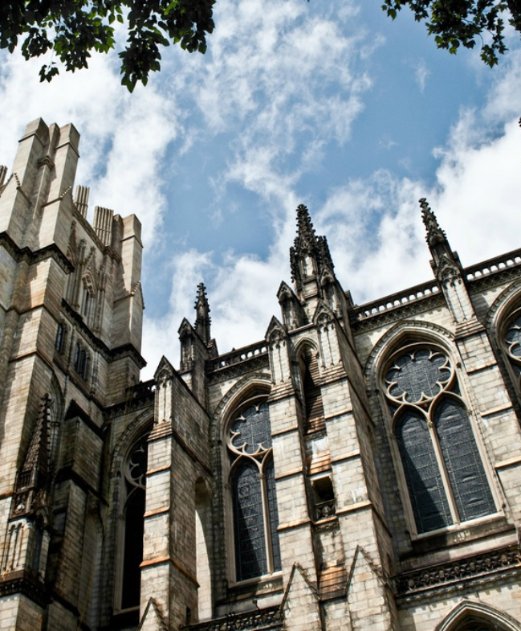
Finally, the traveler came to the third bricklayer, who was working with a radiant sense of joy and purpose. The traveler asked him the same question, “What are you doing?”
With a broad smile and eyes full of passion, the third bricklayer replied, “I’m building a magnificent cathedral!
It will stand for generations and inspire awe in all who see it.
I’m part of something much larger than myself.”

Slide 25
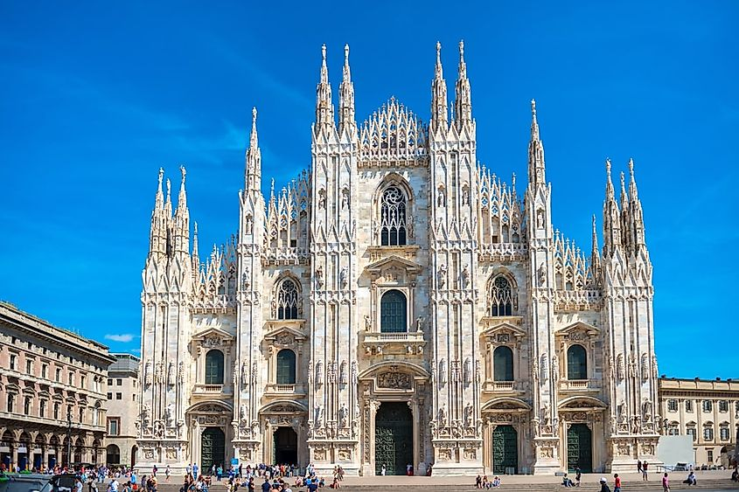
We are building cathedrals …

Slide 26
If not me, then who?
If not now, then when?

Slide 27

Volunteering
The Starfish Story:
A young girl was walking along a beach where thousands of starfish had been washed ashore by the tide. As she walked, she picked up one starfish at a time and gently threw it back into the ocean.
An old man was watching her and said, "There are too many starfish on this beach. You can't possibly make a difference."
The girl smiled, picked up another starfish, and threw it into the sea. "It made a difference to that one," she said.

Slide 28
Volunteering Is Like Saving Starfish
You do make a difference, sometimes slowly
You eat an elephant one bite at a time
Slow and steady wins the race
We cannot be all things to all people
Pick the mission and execute on the mission

Slide 29
Strategic Goals
2024-2025
Increase civic participation within existing Civic Leagues
Increase number of active Civic Leagues in the City
Strengthen communication with city government
Be the Lead for Citizen advocacy on key issues (land use, development, public services)
Expand community outreach programs
Start new Civic Leagues where there are none
Concentrate on HOA’s to join the VBCCO

Slide 30
Short-Term Milestones (2024-2025)
Host 3-5 civic forums or events annually
Grow Civic Organization membership to 150
Work on website redesign
Strengthen social media presence
Establish 2-3 new city partnerships
Help establish and organize “joint venture” events with multiple nearby Civic Organizations (Thalia, Birchwood, King’s Forest District 8 Candidate Forum October 21, 2024

Slide 31
Key Projects and Initiatives
“Conversations with the City” series
Civic League support programs-what can the VBCCO to help your Civic Organization
Youth civic engagement programs
“One Voice” Representation: VBCCO as the unified voice of Civic Leagues, serving as the key liaison between member Civic Leagues and City Government
Permanent VBCCO Seats: Secure permanent seats on the five most important City Boards and Commissions
Advocating for Homeowners: Champion initiatives that directly benefit established suburban neighborhood homeowners, focusing on their needs as taxpayers and voters

Slide 32
How are we going to do all that?
Your guess is as good as mine…
Let’s start by filling up the vacant volunteer spots in the VBCCO
Let’s collaborate on ideas to make our citizen voices strong and respected with City Government
Let’s get a “seat at the table”

Slide 33
How are we going to do all that?
Member engagement: Growing volunteer team strength
Financial resources: Find more money - fundraising
External partnerships: Support/Donations from businesses and local institutions
Create a High-Functioning Board of Directors
Have Engaged Officers
Have Engaged Volunteers

Slide 34
Vision Map Timeline
2024-2025
Q4 2024 – Finish year at 100 Member Civic Organizations
Q1 2025 – Seat new Board of Directors Members
Q1 2025 – Fully Staff Committees
Q1 2025 – Identify Civic Organization needs – help fulfill
Q2 2025 – Hold Spring “Event” – Social for Members and Dignitaries
Q2 2025 – Regain VBCCO seat on RAC Committee – install on others
Q3 2025 – Officer Elections
Q4 2025 – end year with 150 Civic Organization Members

Slide 35
VBCCO Vision Map: Forward-Looking Initiatives
1. Community Engagement and Unity
Forums for Collaboration: The VBCCO serves as a hub for neighborhood civic organizations to work together. It emphasizes educating, informing, and empowering civic leaders, supporting stronger neighborhood development, and building a united voice for advocacy in city matters.
"Conversations with the City" Initiative: Regular forums facilitate dialogue between citizens, civic leaders, and city officials, addressing development projects, zoning issues, and city planning. This program aims to keep residents informed and involved in local decision-making.

Slide 36
VBCCO Vision Map: Forward-Looking Initiatives
2. Sustainability and Quality of Life
Green and Resilient Neighborhoods: Initiatives like tree planting, community gardens, and stormwater management programs are promoted to enhance the sustainability and resilience of neighborhoods. The VBCCO collaborates with city officials to create solutions that mitigate environmental risks and promote green spaces.
Affordable Housing Advocacy: Engaging with the city on affordable housing options ensures that middle and low-income residents have access to sustainable living spaces while preserving the established, suburban neighborhoods

Slide 37
VBCCO Vision Map: Forward-Looking Initiatives
3. Modernizing Communication and Engagement
Digital Platforms for Broader Reach: The VBCCO plans to expand its digital presence through online engagement portals, digital newsletters, and social media. These platforms keep the community updated on city developments, upcoming forums, and volunteer opportunities.
Virtual Meetings: Increasing the use of virtual meetings allows more residents to participate in discussions and decision-making processes, ensuring greater inclusivity.

Slide 38
VBCCO Vision Map: Forward-Looking Initiatives
4. Strengthening Civic Representation
Advocacy and Policy Influence: The VBCCO is committed to representing the interests of neighborhoods by engaging in policy advocacy. This includes working directly with city councils and attending public hearings to ensure community voices are heard.
Public Surveys and Reports: Initiatives like community surveys help gauge residents' concerns, which are then communicated directly to city officials for action and improvement.

Slide 39
Measuring Success
Quarterly meeting with Deputy City Manager Amanda Jarratt
Quarterly meeting with Planning Director Kathy Warren
VBCCO received call from developer 2 weeks after closing on Cypress Point Shopping Center asking for Community engagement - Prompted by District 9 Councilman Schulman and Planning Department
Land Use Reports from Planning Department now in the City Manager’s Friday Package – (3rd Friday monthly) letting us know who they are talking to in the Developer Service Center (DSC)
DSC is the beginning of a development application – months before any signs go up or before the application is submitted

Slide 40
Measuring Success
Working on obtaining copy of the Planning Department “pipeline” of who they are talking to and at what stage they are in the conversation
City Staff is now very responsive to email requests for information – Deputy Planning Director Carrie Bookholt answered an email last night at 10:30pm
Invited to breakfast with variety of Councilmembers
Being present as the VBCCO at public events and being recognized as the VBCCO being present

Slide 41
Measuring Success
Meeting Membership growth targets
Feedback from VBCCO Member Civic Organizations
Holding more civic forums and community participation events
Receiving positive feedback from community and city officials

Slide 42
VBCCO: Your Partner in Building Stronger Neighborhoods
The VBCCO is working to ensure that every Civic League in Virginia Beach has a strong voice, better access to resources, and a direct link to City Government.
What’s in it for you?
By being a part of the VBCCO, your Civic League gains access to support, training, resources, and advocacy that can make your neighborhood a better place to live. We’re here to help you be heard, be informed, and be empowered to make lasting improvements in your community.

Slide 43
Advocacy and Representation
Actively advocate for the concerns of member Civic Leagues at the local government level, ensuring their voices are heard in decision-making processes.
What it means for you: The VBCCO is your voice at the city level. We advocate for policies that benefit your neighborhood and ensure that your concerns are heard by City Council and local officials. We’re fighting for permanent seats on key city boards and commissions to make sure you have a seat at the table.

Slide 44
Resource Sharing
Provide access to resources or guidance on how to secure funding for neighborhood projects, and offer shared tools such as templates for bylaws and newsletters.
What it means for you: Need help getting a project off the ground? The VBCCO connects you with funding opportunities, templates for managing your organization, and access to shared resources, making it easier for your Civic League to make an impact.

Slide 45
Facilitating Collaboration
Foster collaboration among Civic Leagues by organizing events, forums, and meetings where they can share experiences, best practices, and strategies for success.
What it means for you: You’re not alone. The VBCCO brings together Civic Leagues from across Virginia Beach to share ideas, experiences, and best practices. Together, we’re stronger and better able to tackle the issues that matter most to our communities.
Example: Thalia, Birchwood and Kings Forest Civic Leagues are holding a join District 8 City Council Candidate Forum on October 21, beginning at 6:30pm

Slide 46
Communication and Information Sharing
Serve as a central hub for disseminating important information to member Civic Leagues, including regular newsletters and updates on local government decisions and city projects.
What it means for you: Stay informed. The VBCCO serves as a hub for important information, providing you with updates on city projects, upcoming events, and key issues affecting your neighborhood, so your Civic League always has the latest insights.

Slide 47
Public Relations and Visibility
Help raise the visibility of member Civic Leagues by promoting their projects and events through the Civic Organization’s platforms, and launch citywide public awareness campaigns.
What it means for you: We help put your Civic League in the spotlight. Through our platforms, we promote your achievements, events, and neighborhood projects to increase visibility and community engagement.

Slide 48
Special Projects and Initiatives
Organize citywide or regional neighborhood improvement initiatives and collaborate with local authorities to implement community safety programs.
What it means for you: Participate in citywide initiatives and improvement projects that make your neighborhood better. From community cleanups to public safety programs, VBCCO helps organize efforts that benefit your Civic League directly.

Slide 49
Celebrating Civic Engagement
Reestablish annual awards or recognition programs to celebrate the achievements of Civic Leagues and organize events to celebrate civic engagement.
What it means for you: We recognize and celebrate the hard work of Civic Leagues. Whether through awards, events, or community celebrations, the VBCCO highlights the value of your contributions, giving you the recognition you deserve.

Slide 50

Bringing the Vision to Life
Together, we build a brighter future for Virginia Beach.

Slide 51
Bringing the Vision to Life
Challenges
  Declining participation and engagement by citizens
  Aging Membership in Civic Organizations
  Attracting new Leaders and Volunteers
  Funding
  Maintaining relevance to neighborhoods
  Finding Volunteers to run and staff standing Committees
  Conflict resolution between and inside of Civic Organizations

Slide 52
Bringing the Vision to Life
Who is going to pay for this?
Fund Raising
  Oyster Roast
  Chili Cookoff
  Picnic
  Golf Tournament
  Donations
  Benefactors
  Other

Slide 53
Finally

Slide 54
Those who say it cannot be done…
Should not interrupt those who are doing it.
George Bernard Shaw

Slide 55
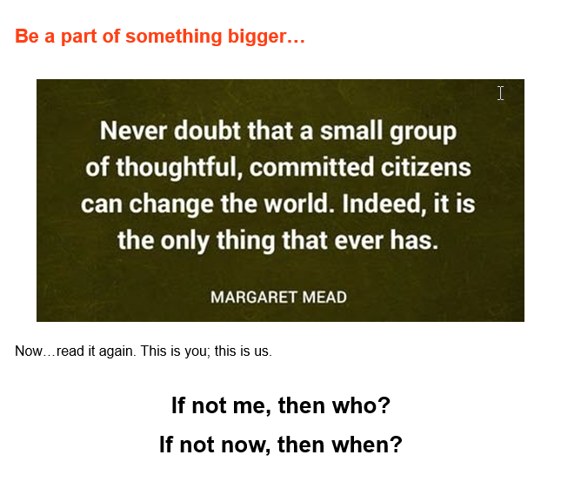

Slide 56
Thank You!
We appreciate your
continuing support.

