Slide 1

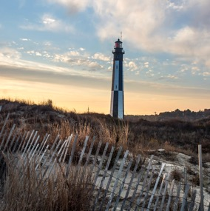
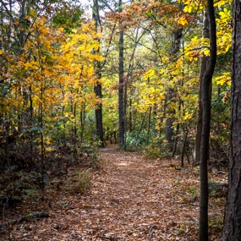

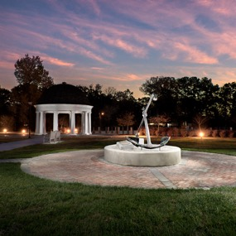
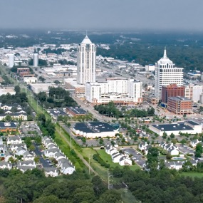


Update & Active Transportation across the City
Steve Lambert I 02.19.2024

Slide 2

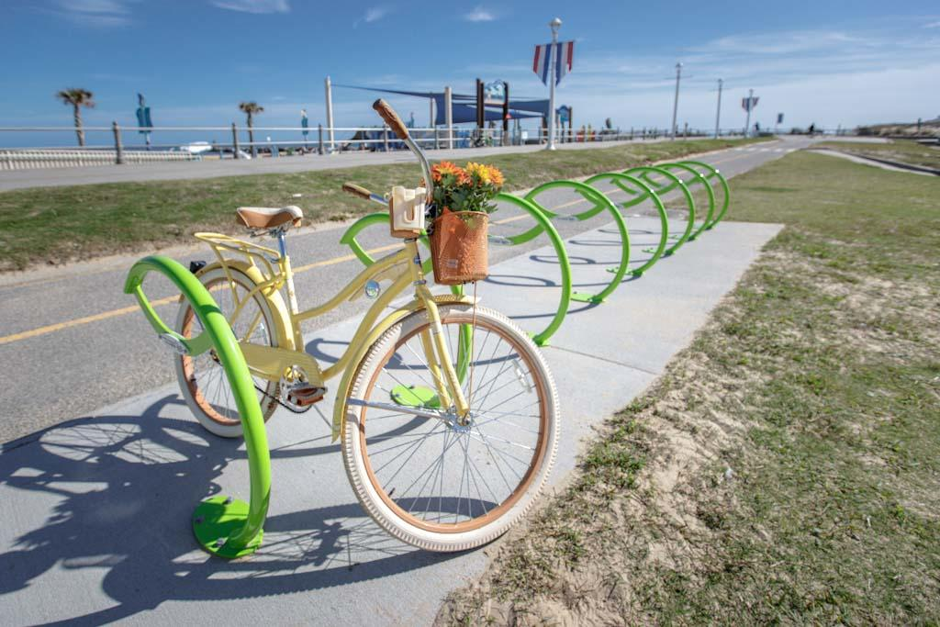
ACTIVE TRANSPORTATION
All forms of human-powered transportation
    Walking
    Cycling
    Wheelchairs
Blueways
    Kayaking
    Canoeing
    Stand-up Paddleboarding
Electric Motor Assisted Vehicles
    E-bikes
    E-scooters
    ADA/Mobility Impaired Transportation
    Micromobility

Slide 3
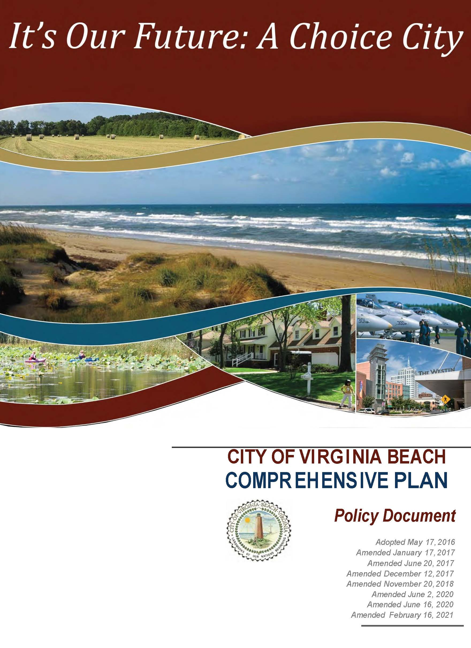
COMPREHENSIVE PLAN
Last Adopted Plan – 2016
Currently being updated
Includes a Master Transportation Plan
  Survey is out right now
Active Transportation Components have been included since 1981

Slide 4
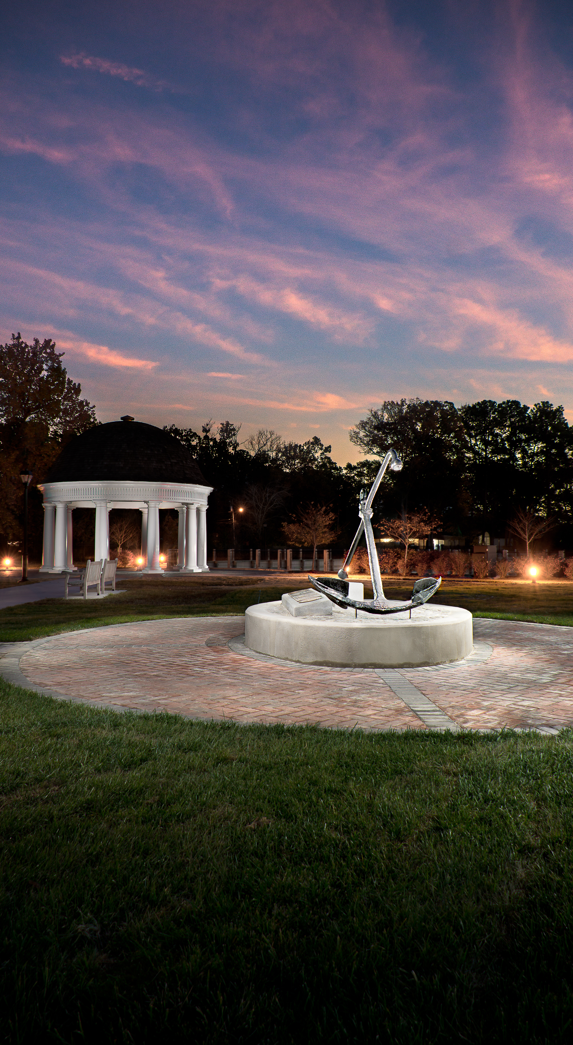
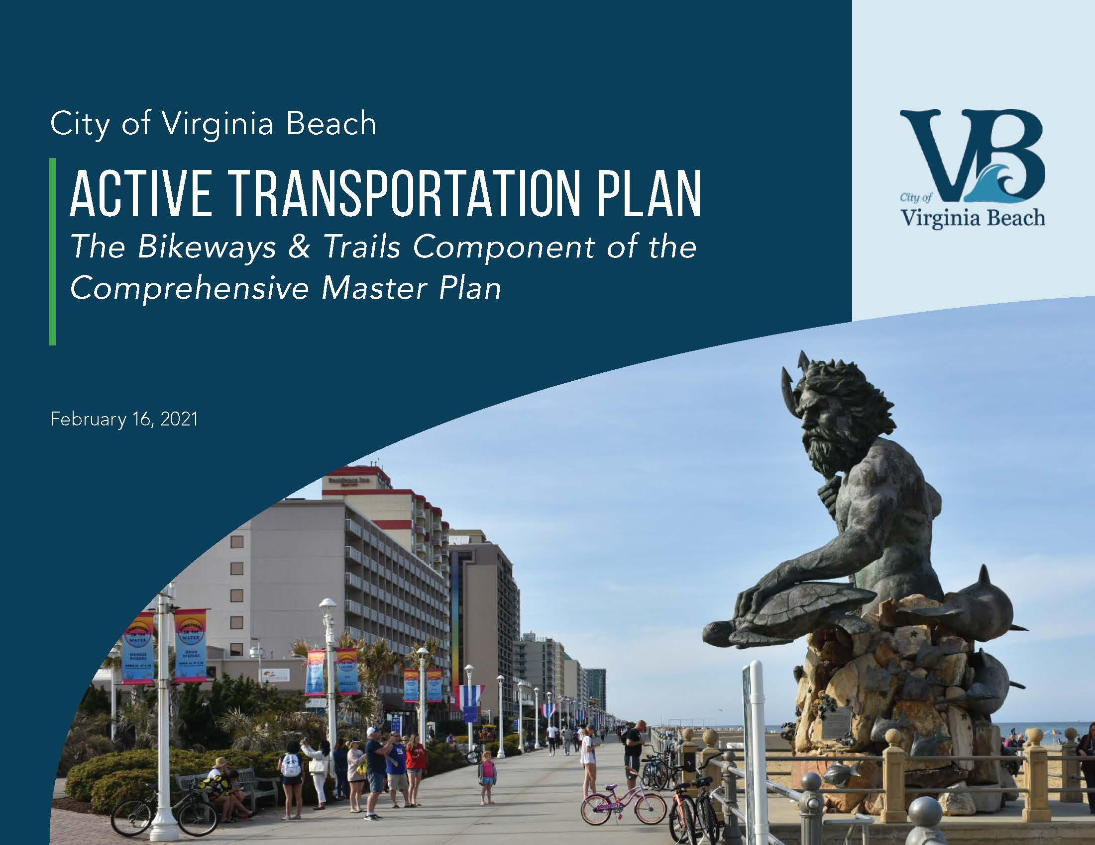
ACTIVE TRANSPORTATION PLAN

Slide 5
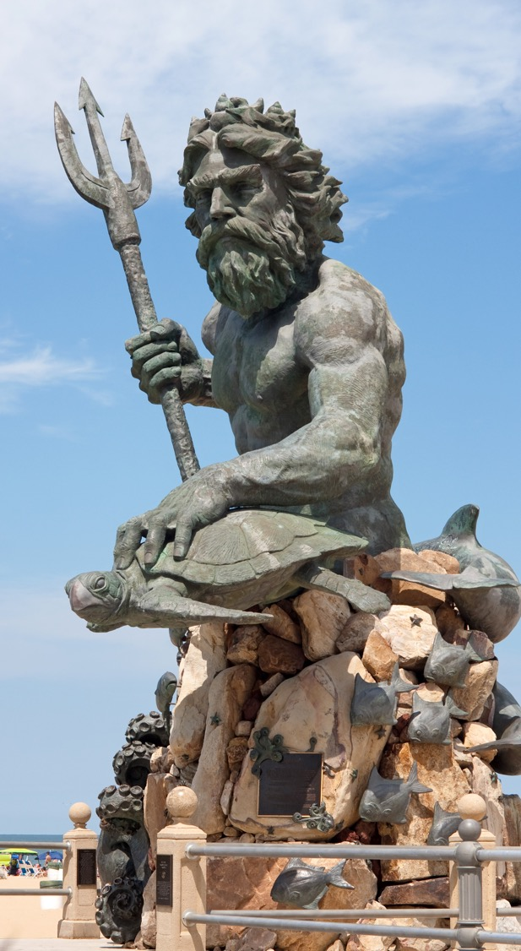
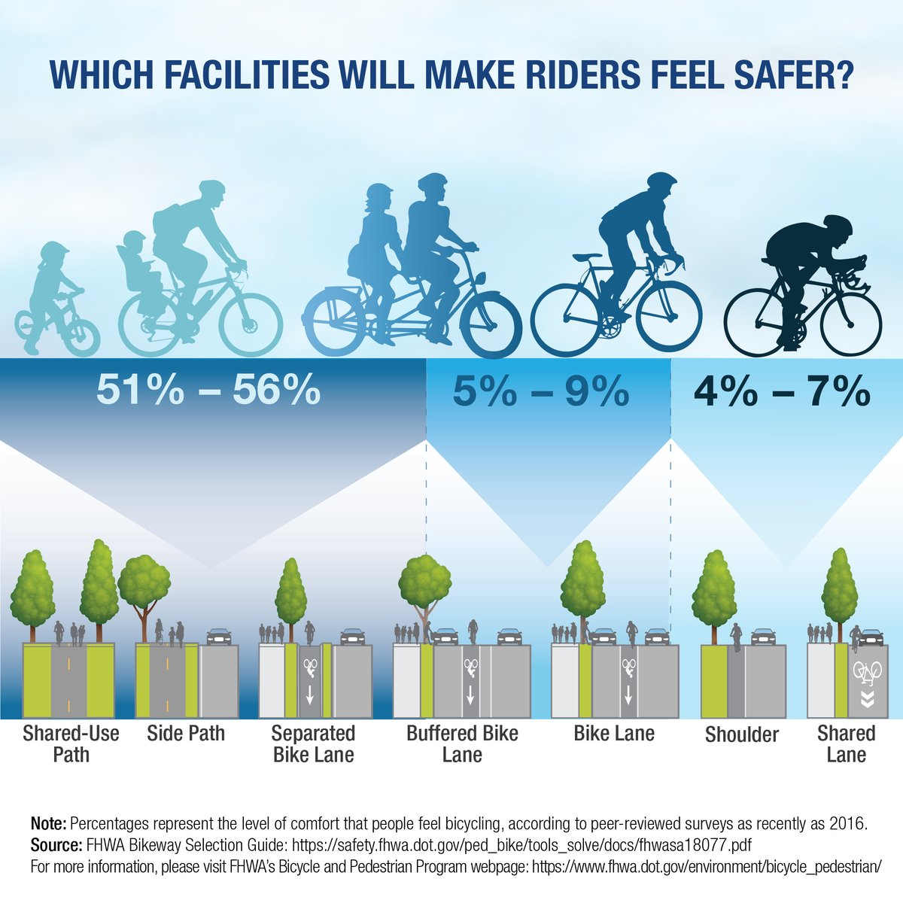
A BALANCED APPROACH

Slide 6
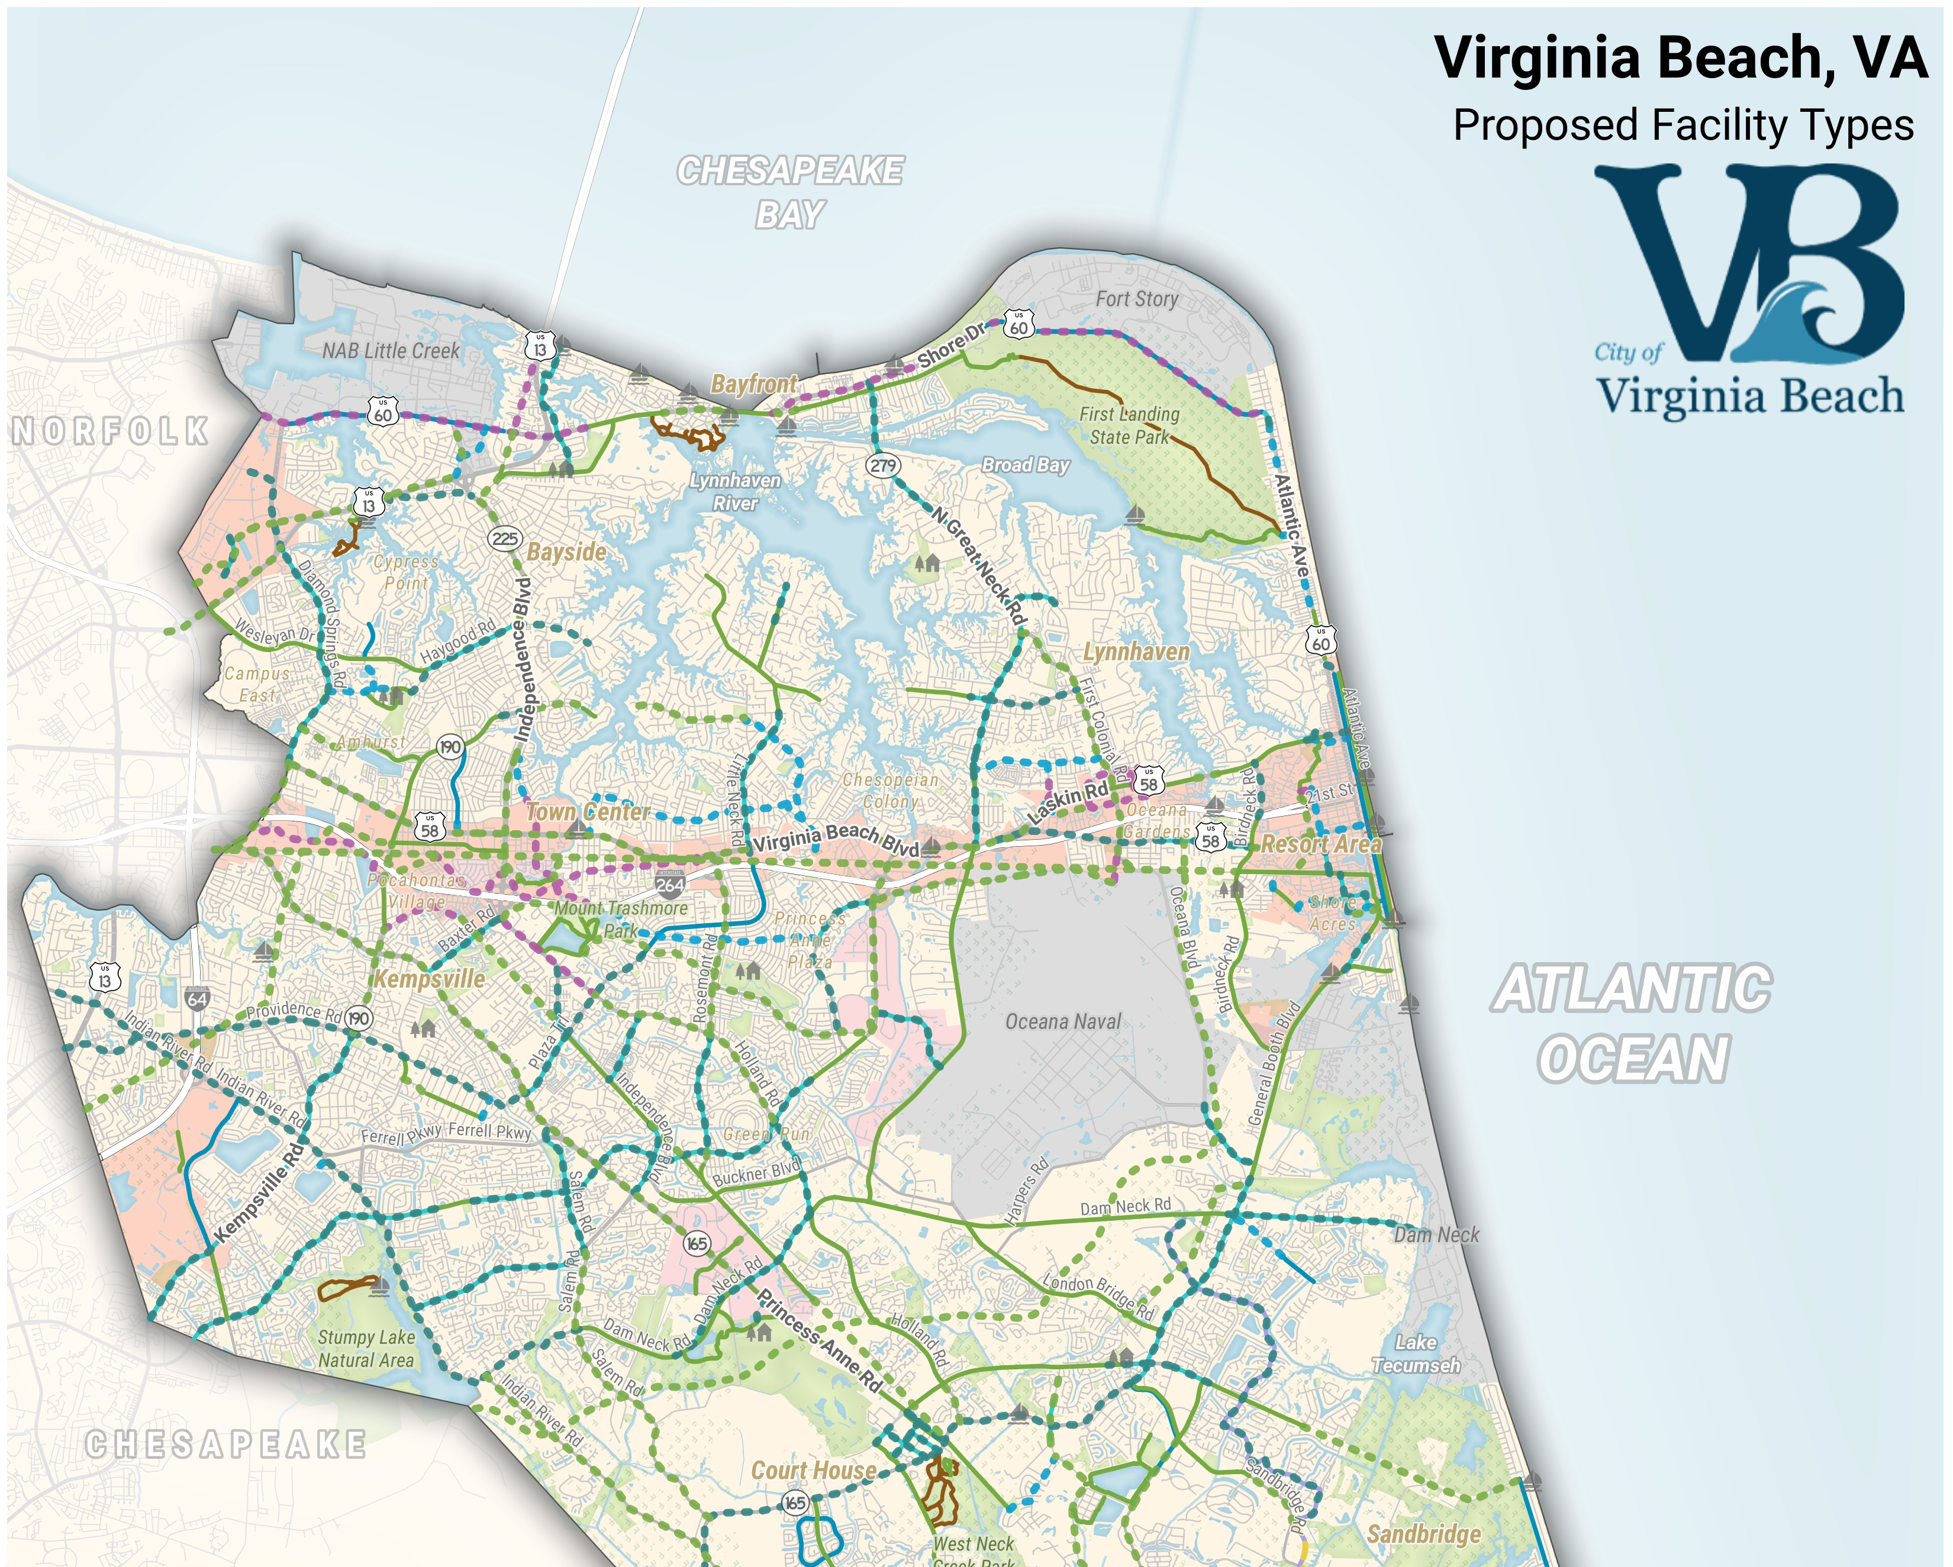
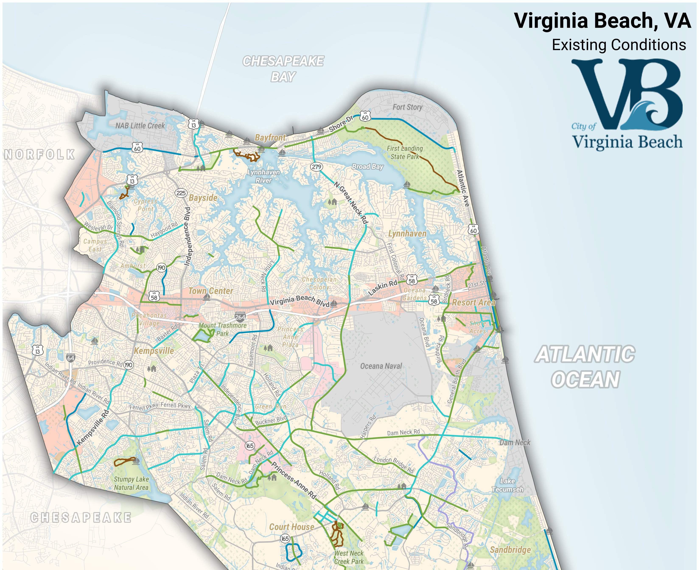
EXISTING CONDITIONS

Slide 7
PROPOSED FACILITIES

Slide 8
HOW DOES IT GET BUILT?
Method | Lead City Agency
Specific Trails, Bikeways & Blueways Projects | Parks & Recreation
Complete Street Policy (New Construction & Repaving Program) | Public Works
Open Space Projects | Parks & Recreation
Public Redevelopment | Economic Development and Public Utilities
Private Development | Planning

Slide 9
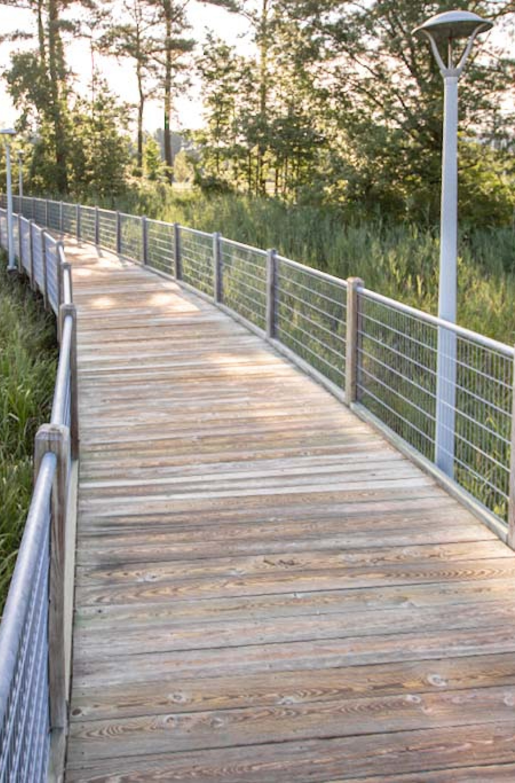
PROJECTS: ONGOING
  Thalia Creek Phase III
  Foxfire Trail
  Three Oaks Path
  Violet Bank Trail
Thalia Creek Greenway Phase II

Slide 10
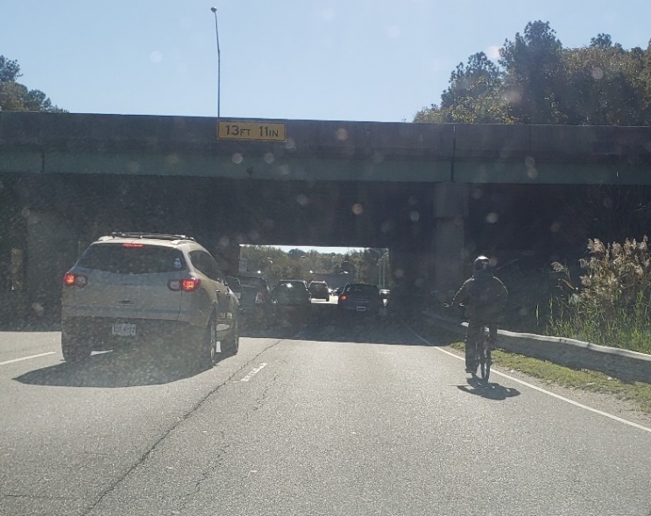
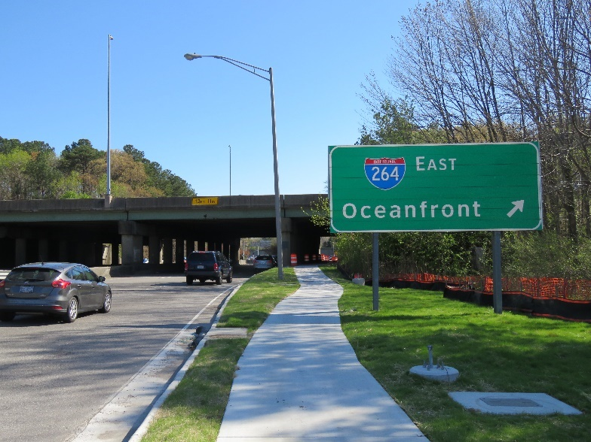
PROJECTS: ROADWAYS
I-264 Interchange Upgrades
Before: Southbound Independence, November 2020
After: Southbound Independence, April 2022

Slide 11
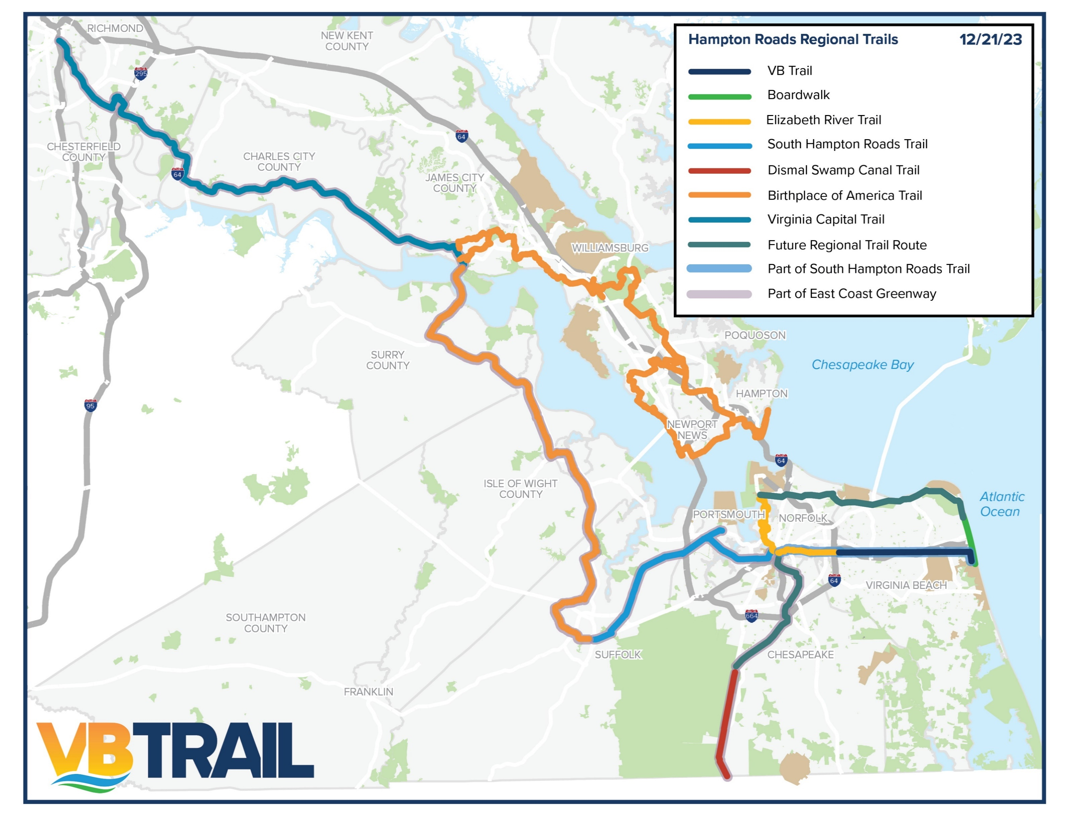
PROJECTS: VB TRAIL

Slide 12
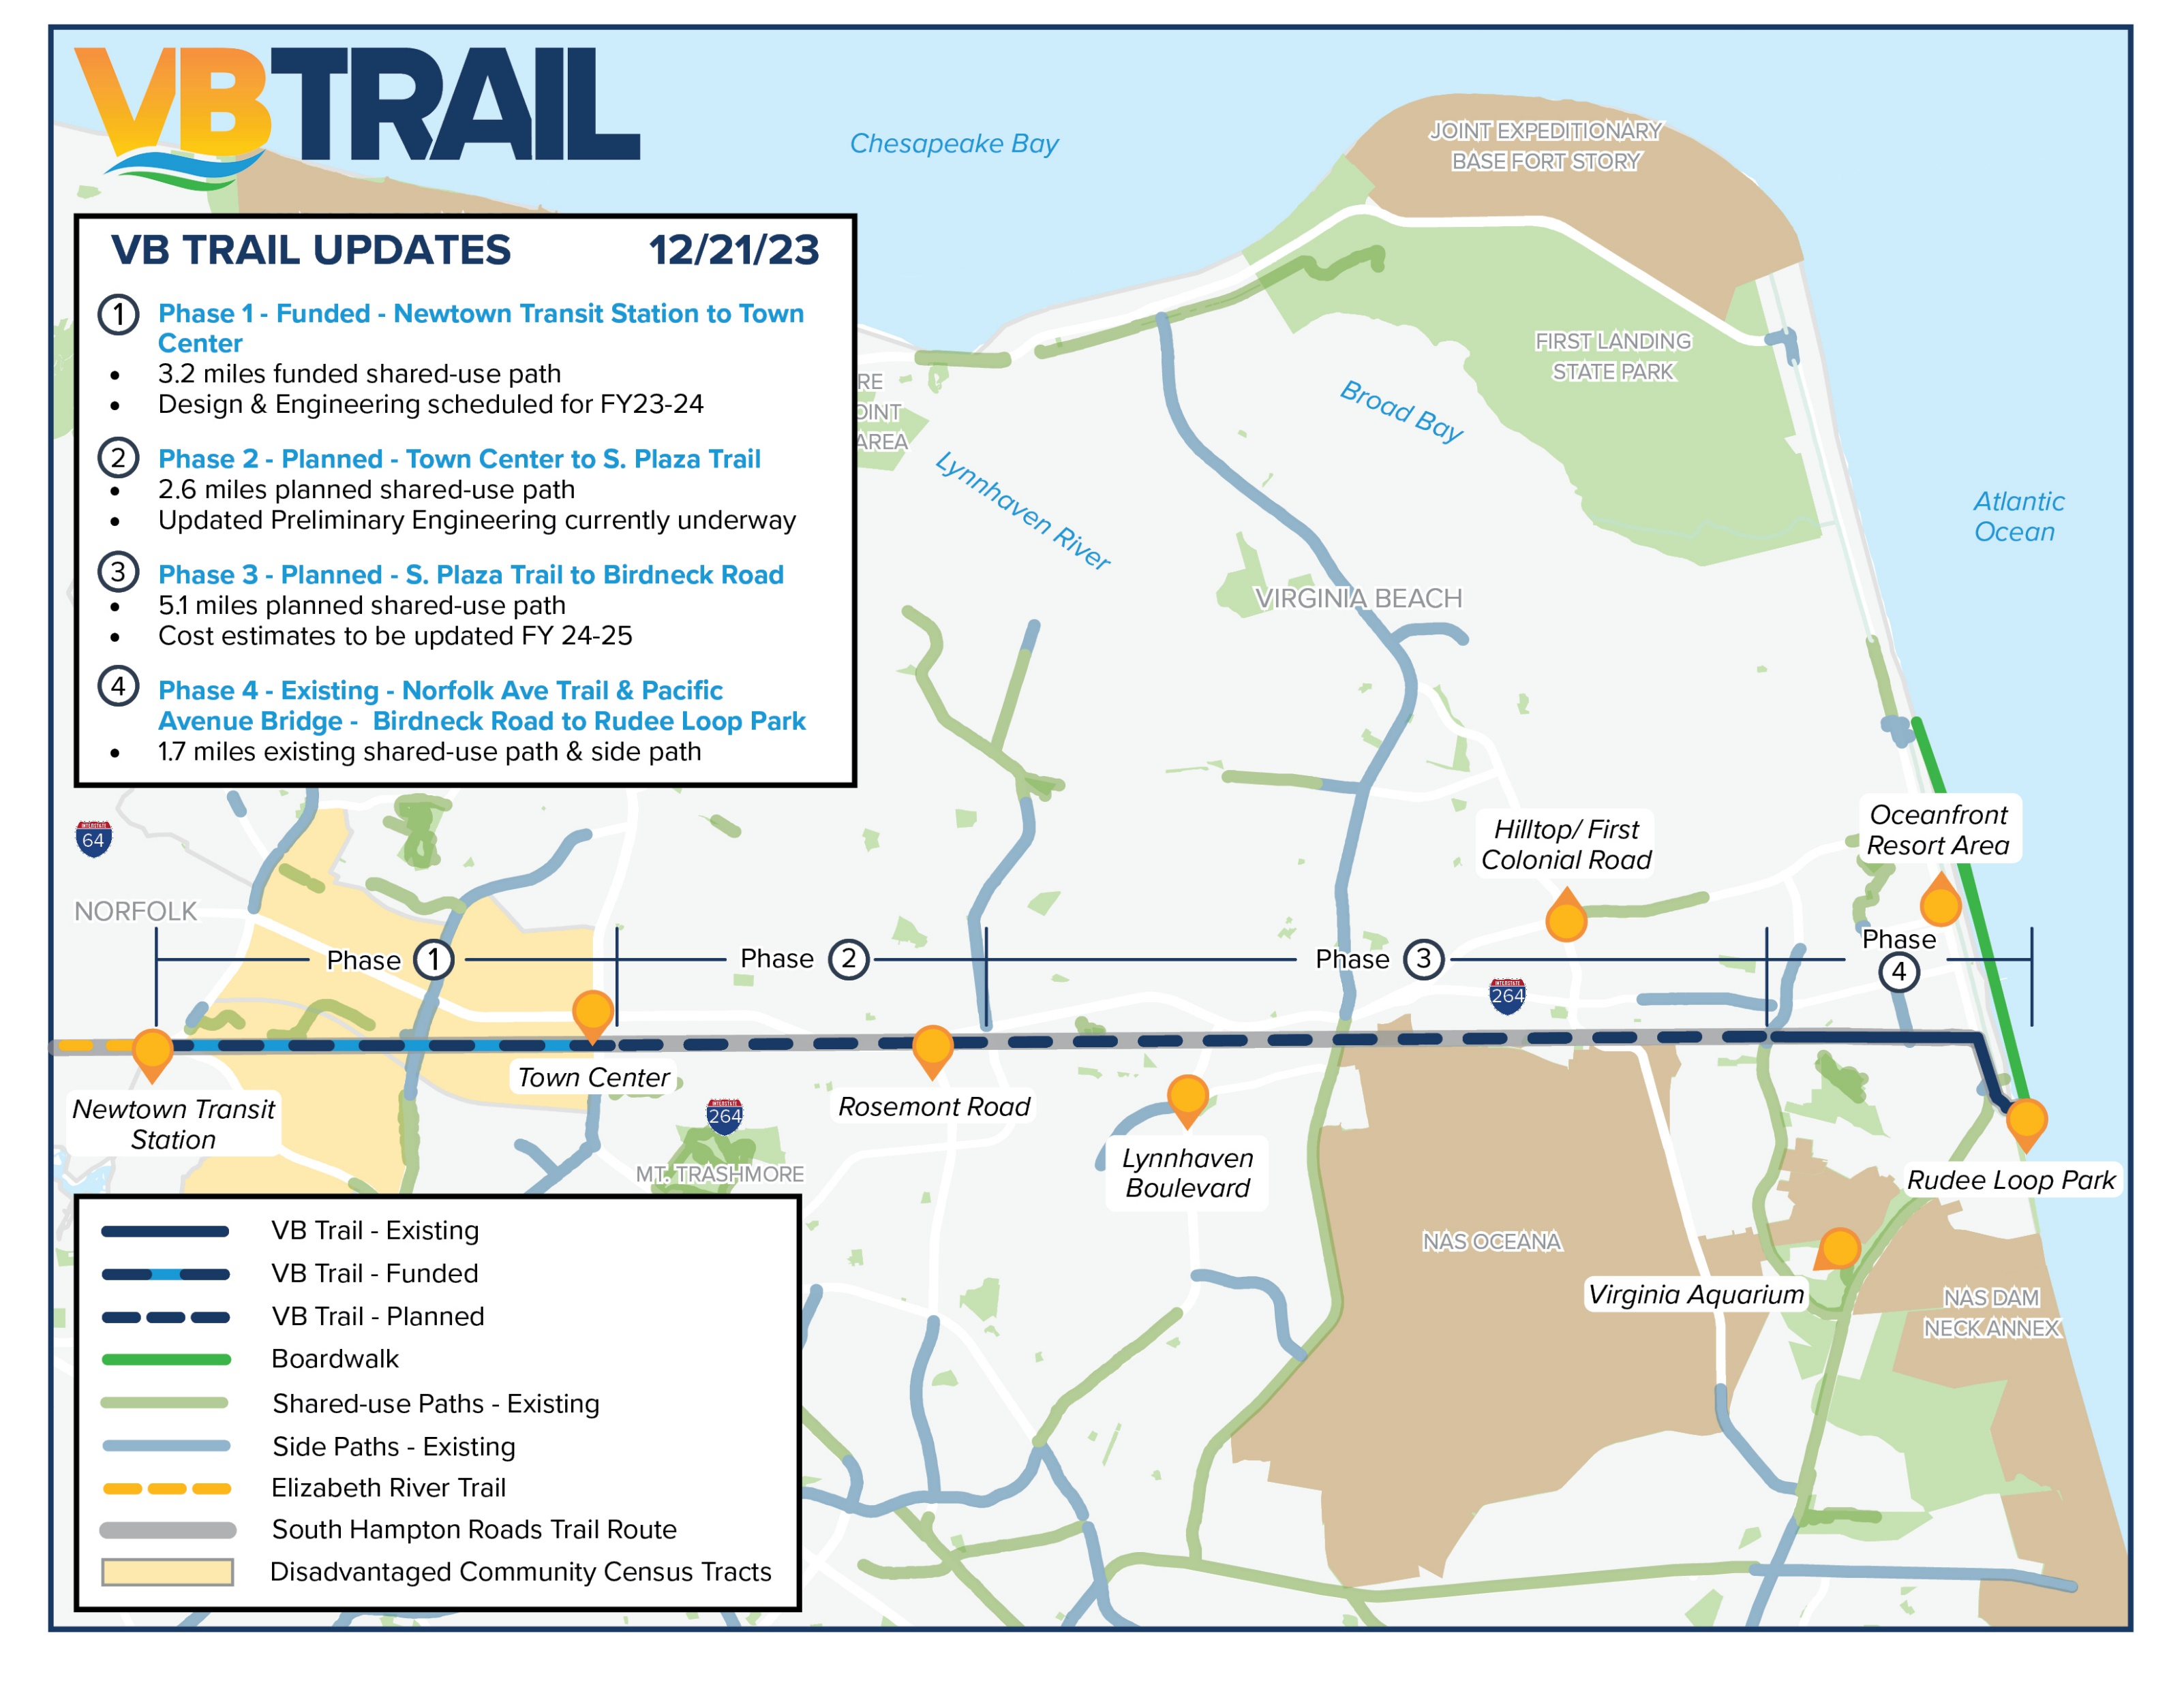
PROJECTS: VB TRAIL

Slide 13
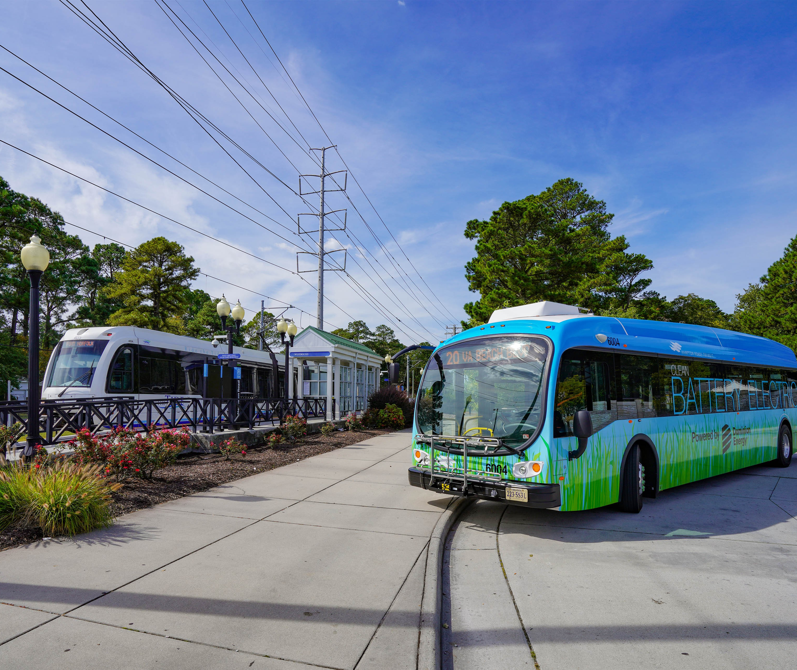
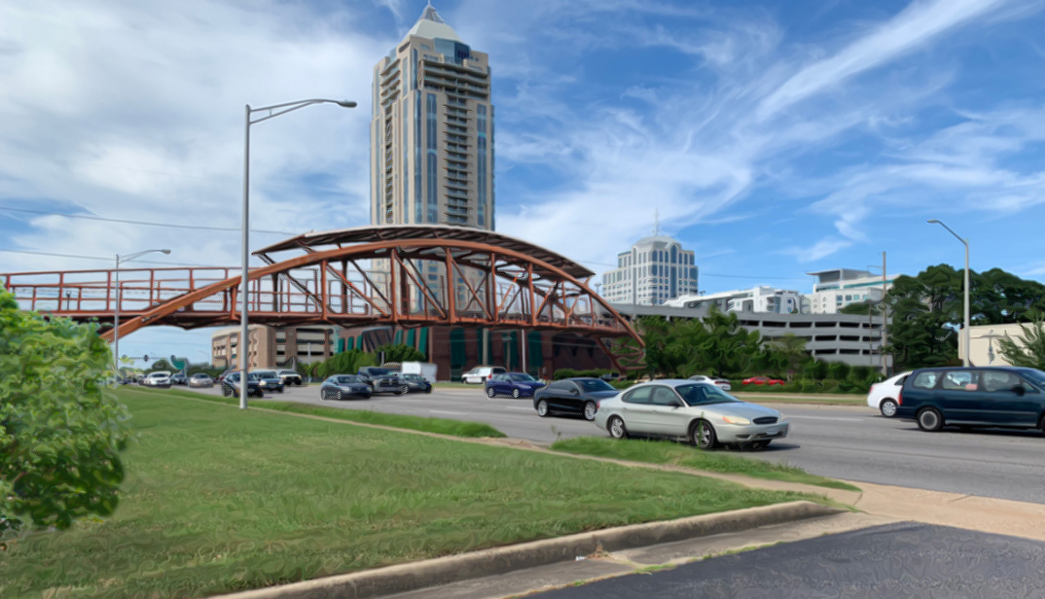
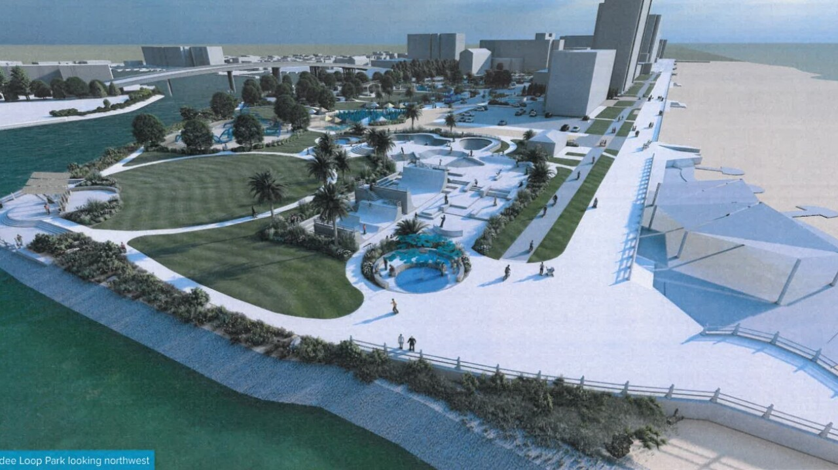
SPANNING THE CITY
Newtown Transit Hub
Town Center
Rudee Park

Slide 14
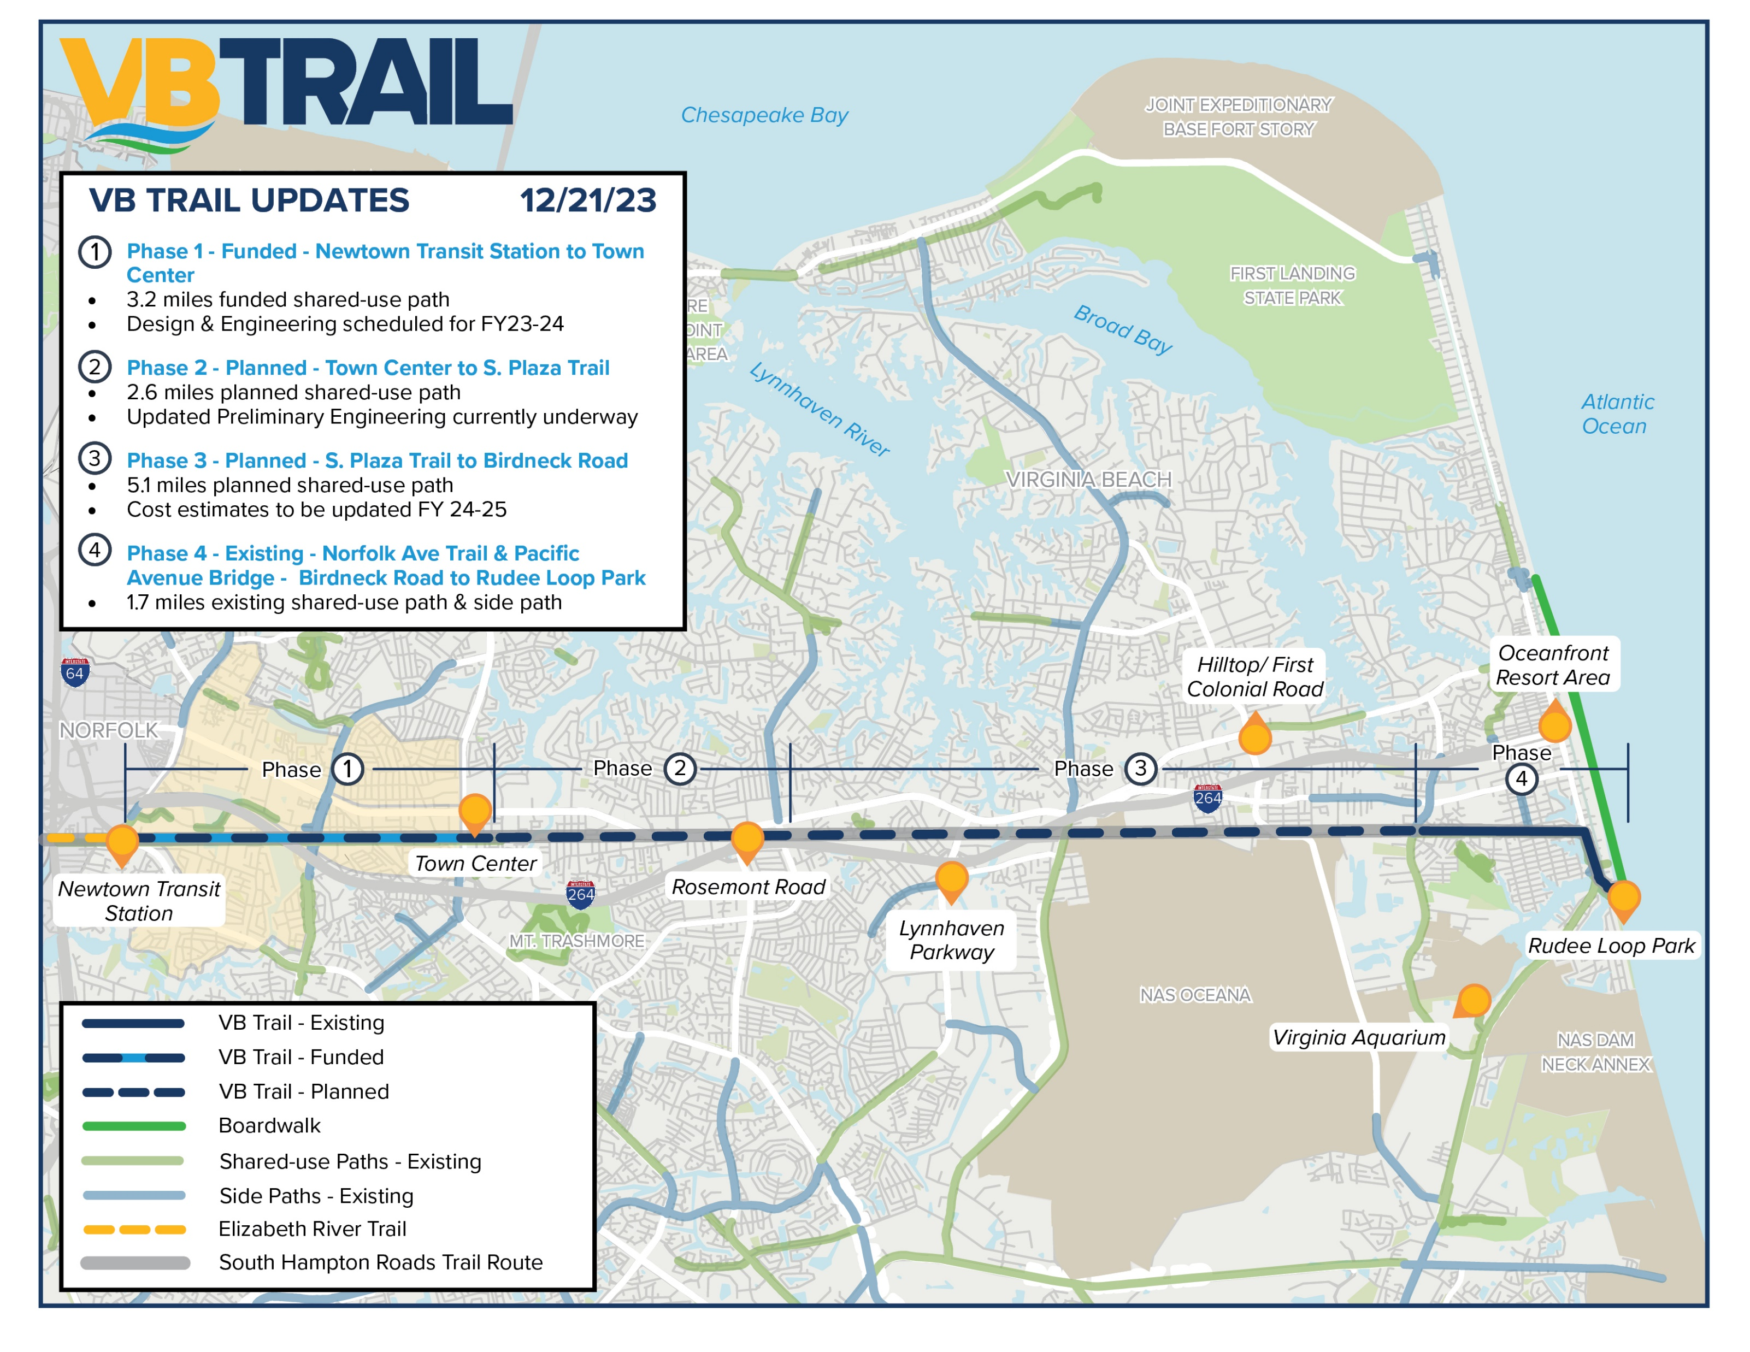
Phases 1 - Funded
$19.5 Million via Federal SS4A program
3.2 miles
Design & Engineering scheduled to start FY 23-24
Includes pedestrian bridge over Independence Boulevard
Will Link Together
Neighborhoods
Schools & Libraries
Workplaces
Transit Stops
Dining & Shopping
Parks & Other Trails
Historic/Cultural Sites
Entertainment Destinations

Slide 15

AND……
  Safe Routes to School
    Crossing Guard Appreciation Day
    Bike/Walk/Roll to School Events
  National Bike Month & Holiday Lights Ride
  Bike Parking Initiatives
  Soft Trails - Marshview & More!
    Cross Country – Local & Sports Tourism
    Mountain Biking & Walking

Slide 16
Thank you
Contact:
Steve Lambert
(757)385-4310
slambert@vbgov.com

Slide 17


Questions?
Contact:
Steve Lambert
(757)385-4310
slambert@vbgov.com

Slide 18
Phase 1 – FUNDED - $19.5 Million via Federal SS4A program
3.2 miles
Design & Engineering scheduled to start FY 23-24
Includes pedestrian bridge over Independence Boulevard
Safety was key component in application
RSA assessment was noted
Phases 2 & 3 – RSA Assessment
RSA was completed Summer 2024
Part of ongoing citywide Local Safety Action Plan (LSAP)
Currently part of Preliminary Engineering Report
Next planned phases to request funding

Slide 19

Regional Connection

Slide 20
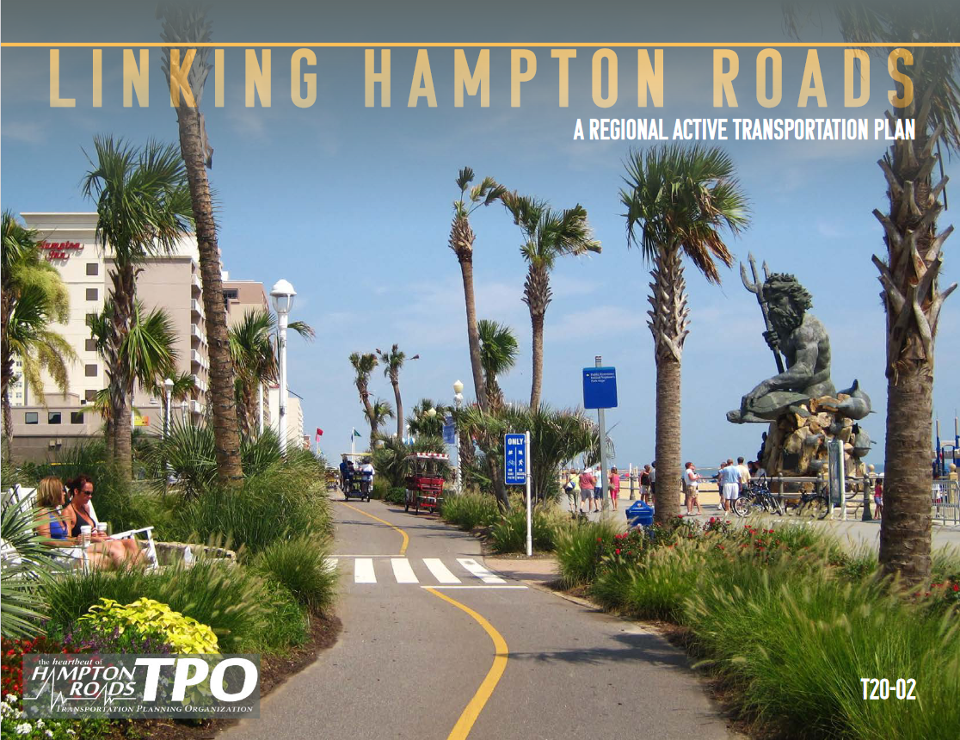

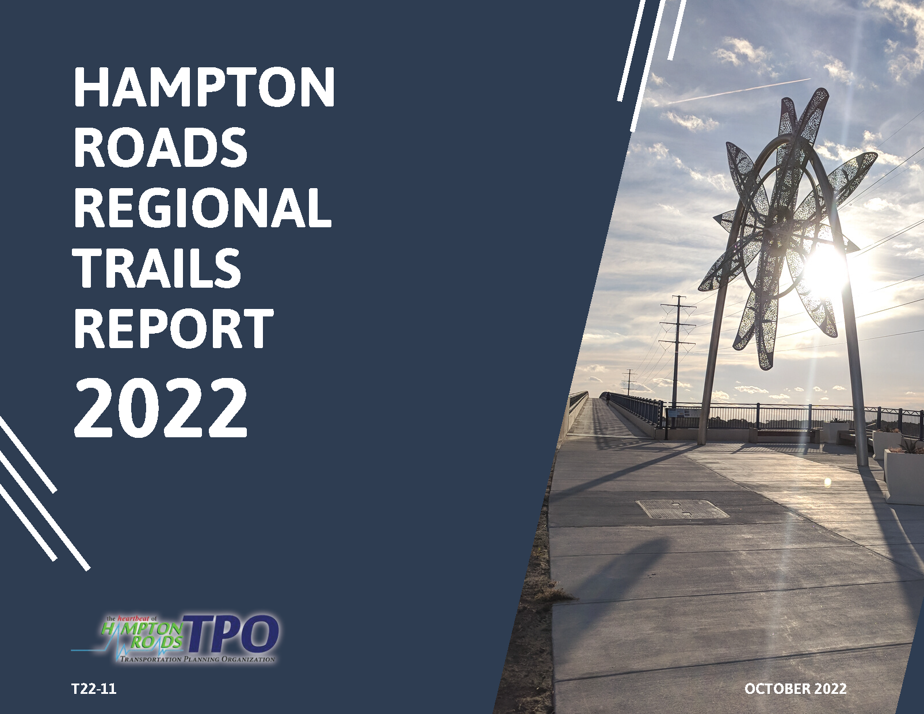
VB Trail
Project limits from Newtown Road, through Opportunity Zones and ending at eastern limits of Town Center
Project designed to 15% construction drawings for entire remaining 10.5 miles of VB Trail
Designed to accommodate future multi-modal needs
Top Transformational Project in the City’s 2021 Active Transportation Plan
Part of the South Hampton Roads Trail route
Included in HRTPO’s Hampton Roads Regional Trails Report and Linking Hampton Roads: Regional Active Transportation Plan

Slide 21
History
1.5 easternmost Miles constructed in 2007
2009 City purchased remaining 10.5-miles of former NSRR 66’ ROW
12-mile Corridor Total that spans the entire width of Virginia Beach, through 6 of our Strategic Growth Areas
10.5-miles remain unbuilt

Slide 22

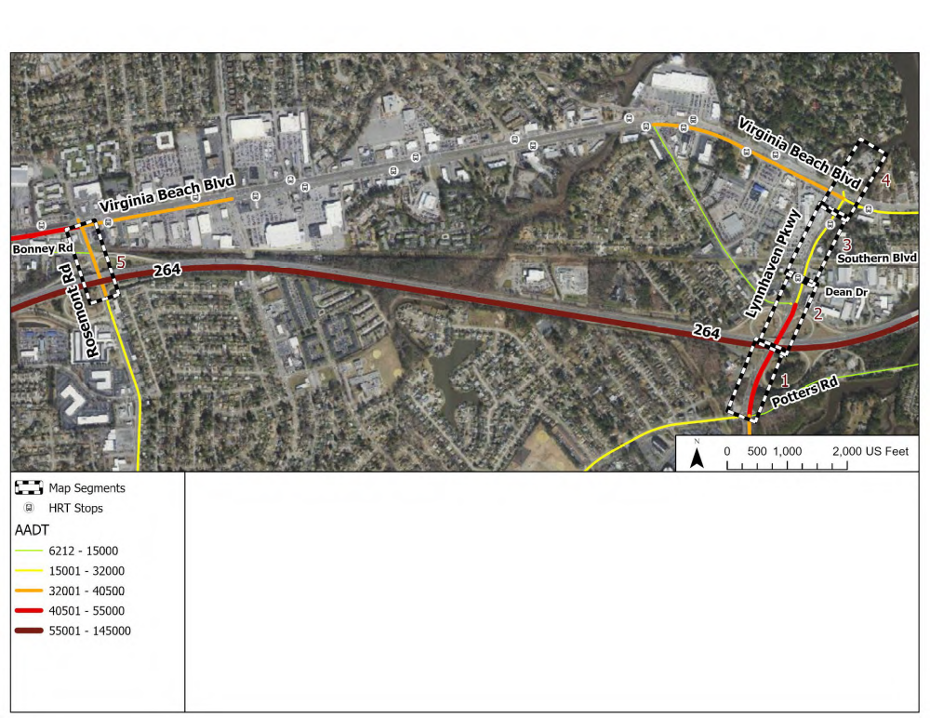
Road Safety Assessment
Two Segments:
Rosemont Road
Lynnhaven Parkway

Slide 23
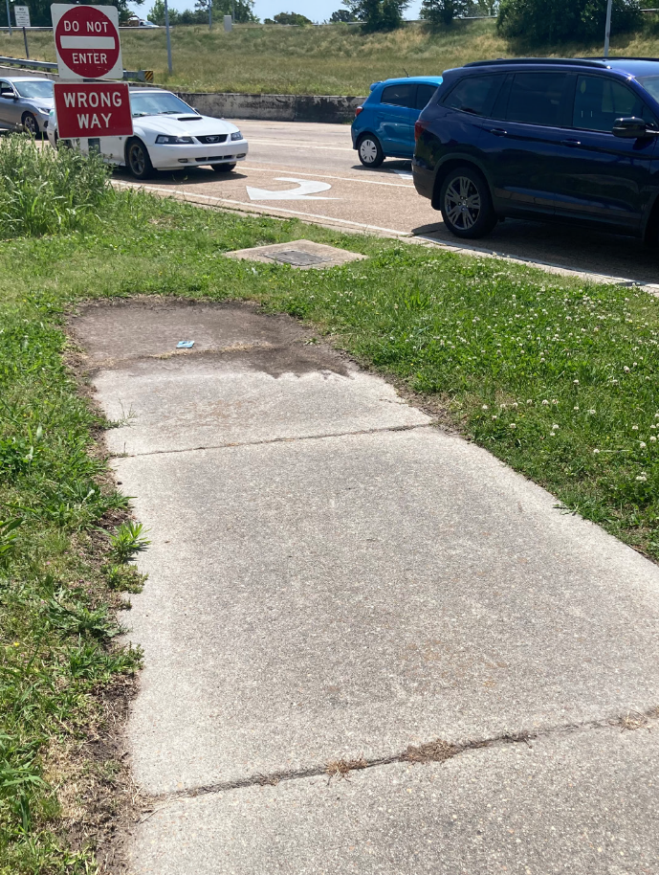
Road Safety Assessment
Recommendations
Lighting
Design and construct safety focused upgrades to entrance/exit ramps of 264 near trail and at intersections
Mid-block crossing at Lynnhaven
Relocate Transit Stops closer to intersection, with future pedestrian infrastructure

Slide 24
Road Safety Assessment
WHY?

